Slide 1


SELSports Rooftop MUGA Installation

Slide 2
Contents
System Overview
Synthetic Grass System
Offsite Prep & Pre-Fab
Pre-start
Fence Post Installation
Waterproofing / insulation
Protective Fleece
Gravel Regulating Layer
Drainage/Sub-Base Replacement layer
Shockpad
Synthetic Grass Surfacing
Jointing & Play lines
Infill
Fence Panel & Roof Net Install

Slide 3
System Overview
Innovative & alternate method of sports facility construction
Design & working method optimised for rooftop locations
Light Weight
Modular
Fully Permeable
Installed directly onto underlying roof construction
Several compatible surface finishes

Slide 4
Synthetic Grass System

Slide 5
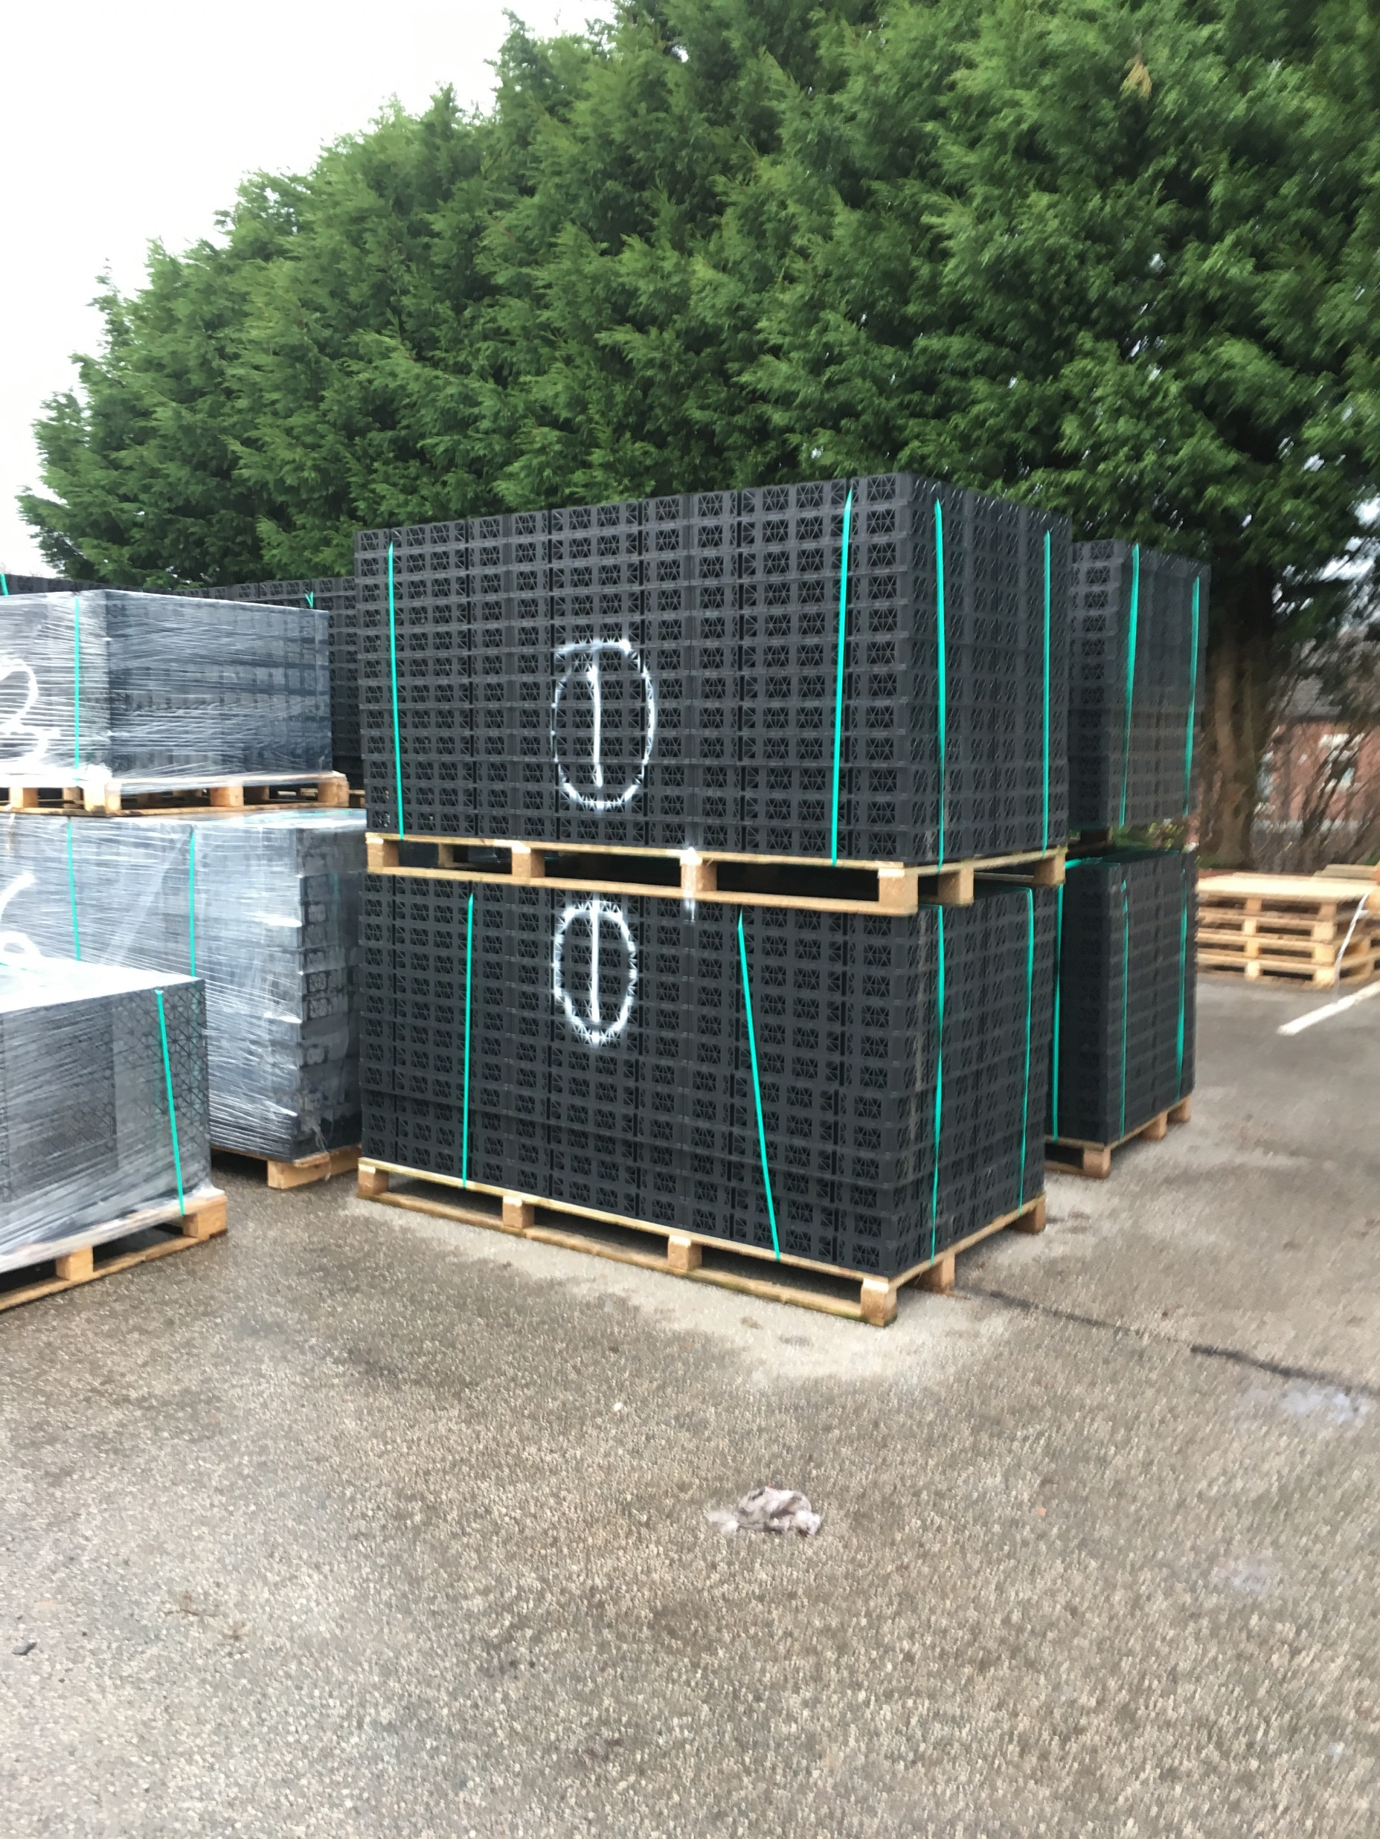
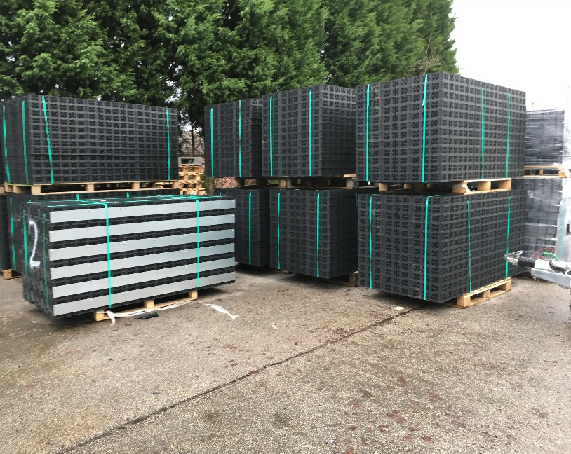
Off Site Preparation & Pre -Fabrication
Where possible materials pre-fabricated off site and delivered to site palletised.
Improves efficiency of lifting operation onto roof.
Reduces install time on-site.

Slide 6
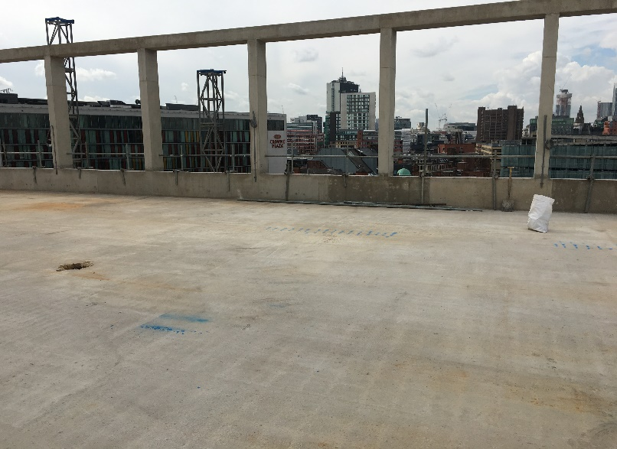
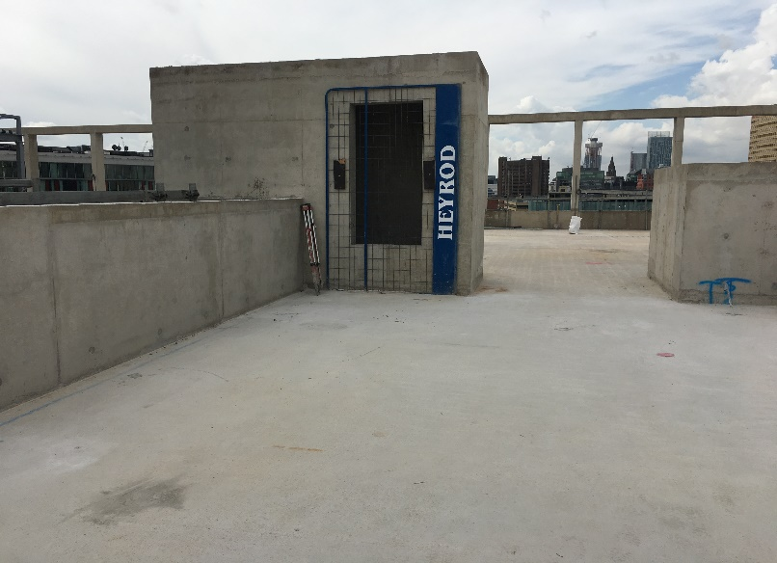
Pre-Start
Installation location to be free of others trades & materials.
Area inspected and accepted by SEL.
Distribution of materials plan put into action.

Slide 7
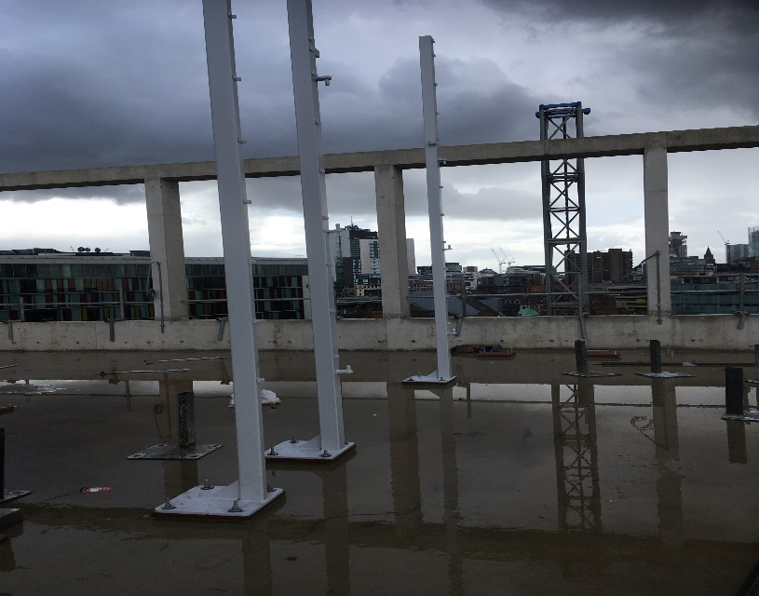
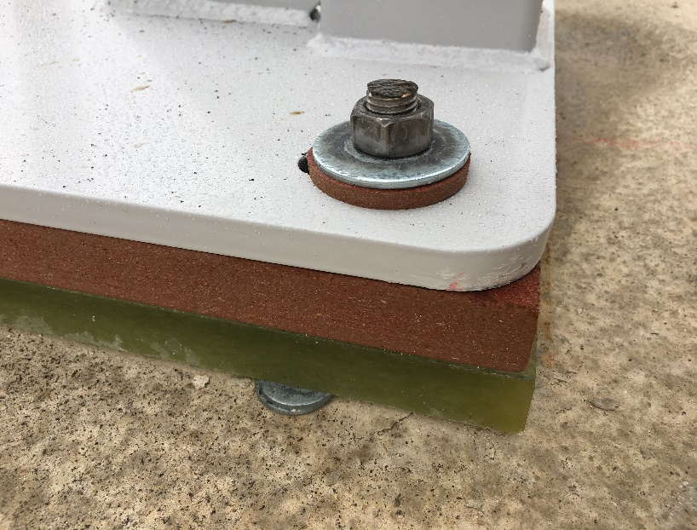
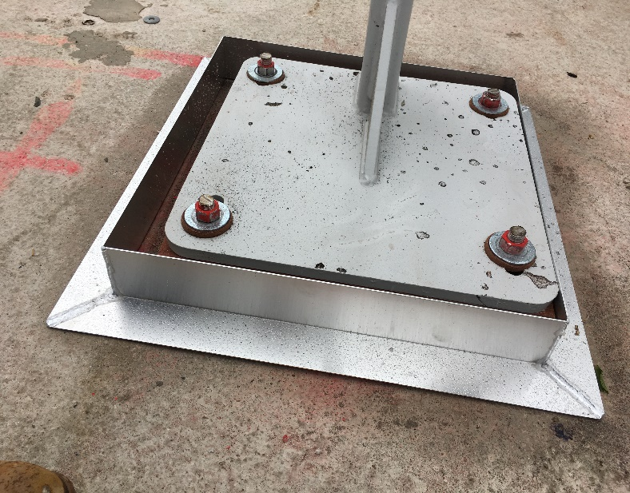
Fence Post Installation
Fence posts set out, marked, and drilled.
Thermal Breaks positioned beneath base plates (if required).
Secured with mechanical anchors in line with fencing design and bolt technical data.
Pitch Pockets (or similar) formed by others prior to waterproofing.

Slide 8
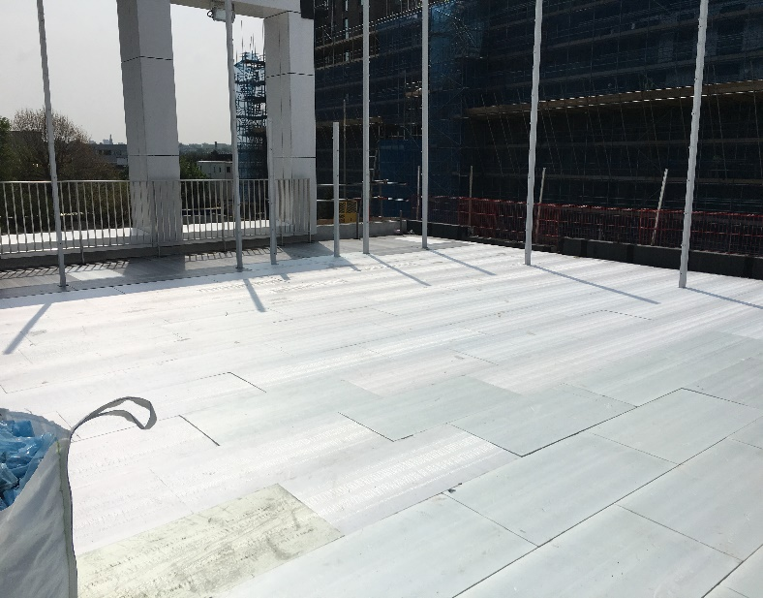
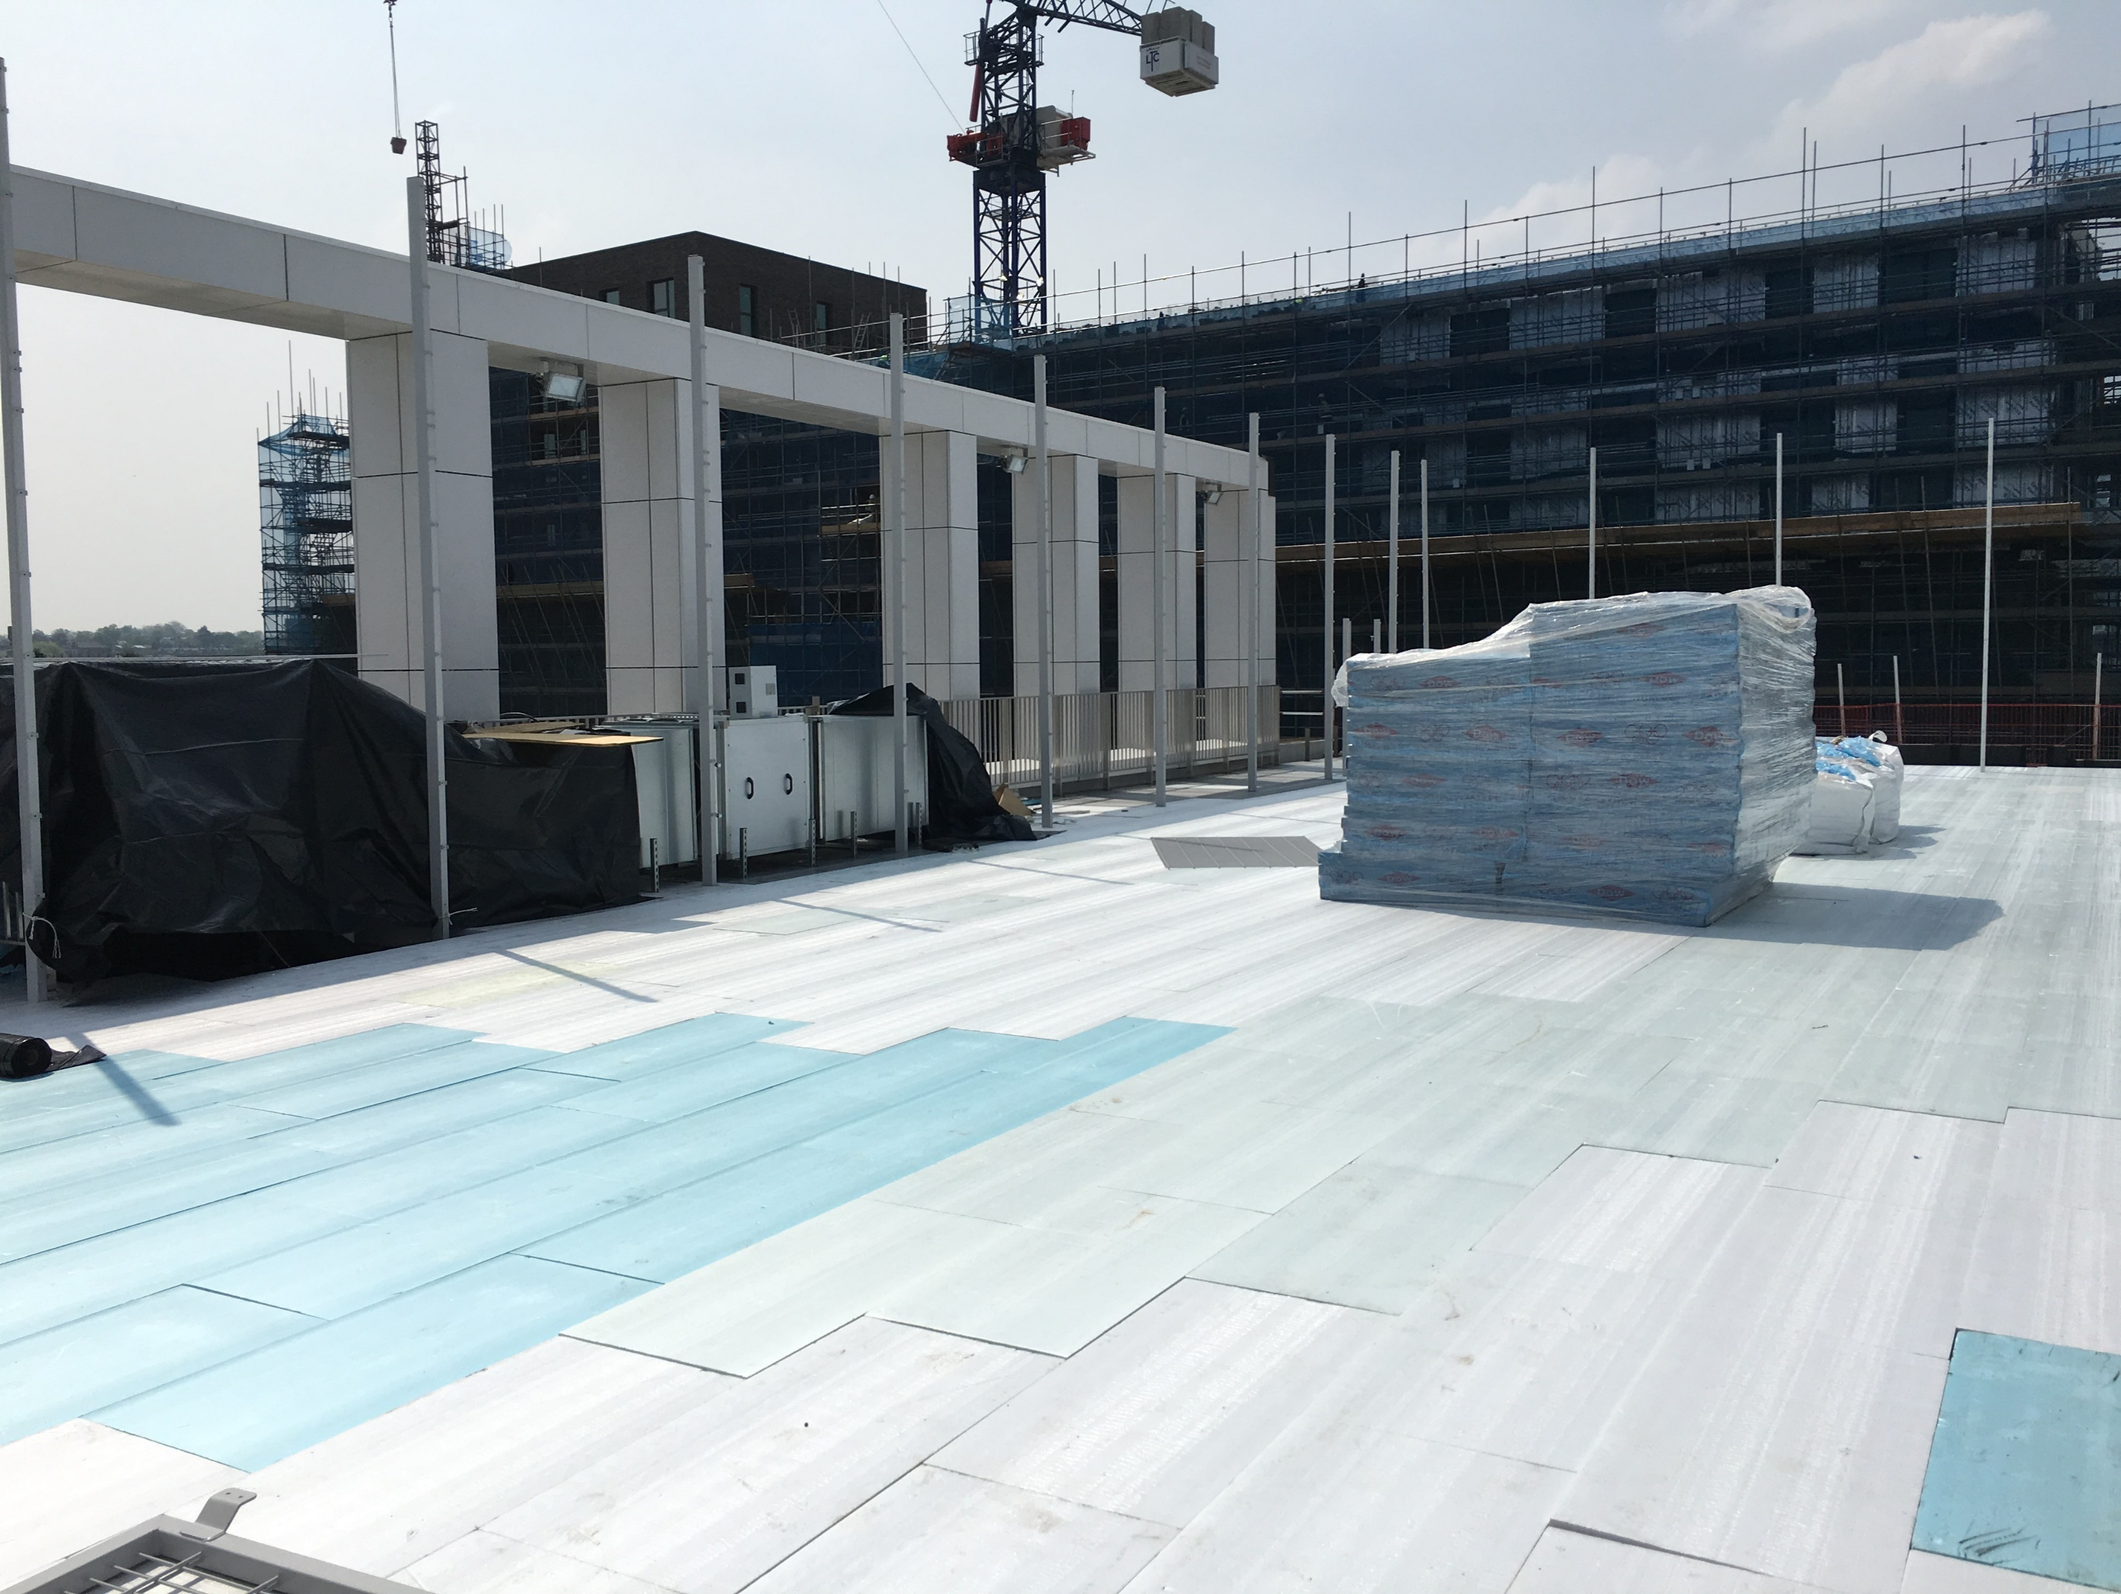
Waterproofing & Insulation
Waterproofing and insulation to be installed (by others) and appropriately signed off.

Slide 9
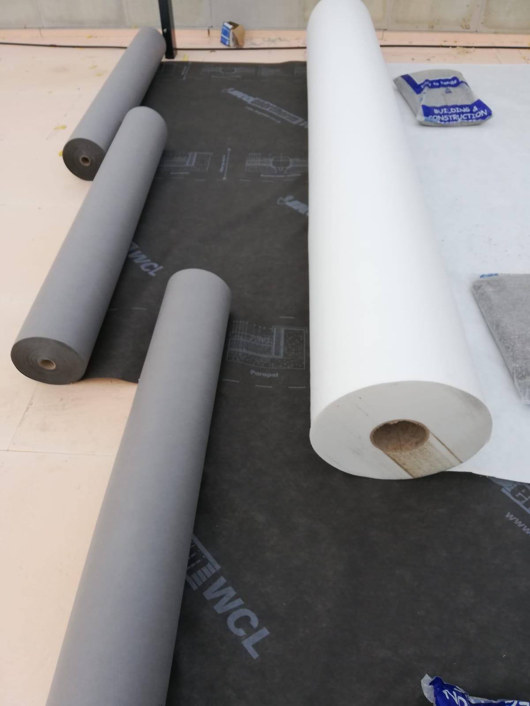
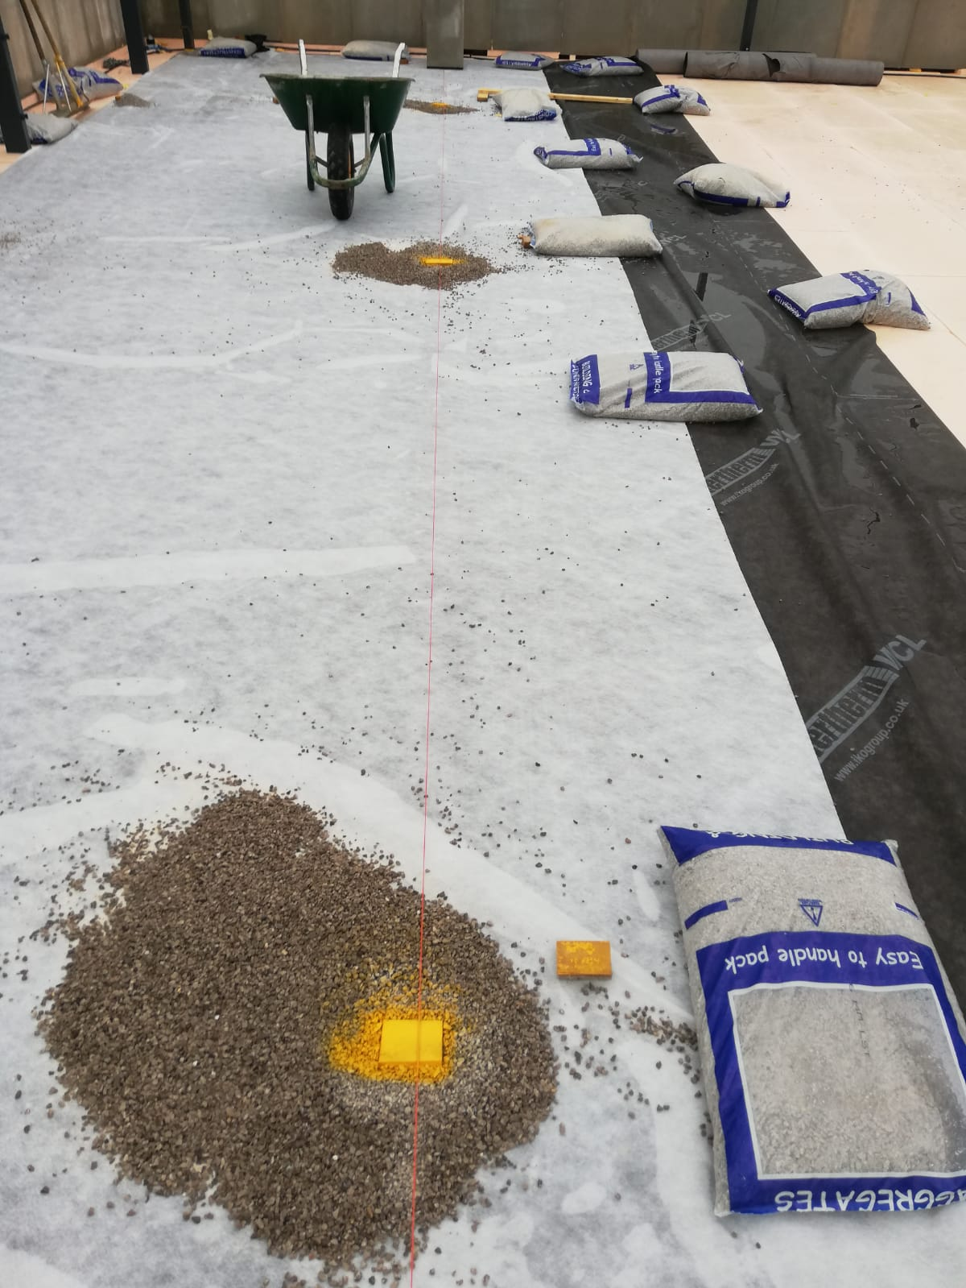
Protective Fleece & Gravel Regulating Layer
Protective geotextile is rolled out over the area.
Depth of gravel is set and maintained using laser level.

Slide 10
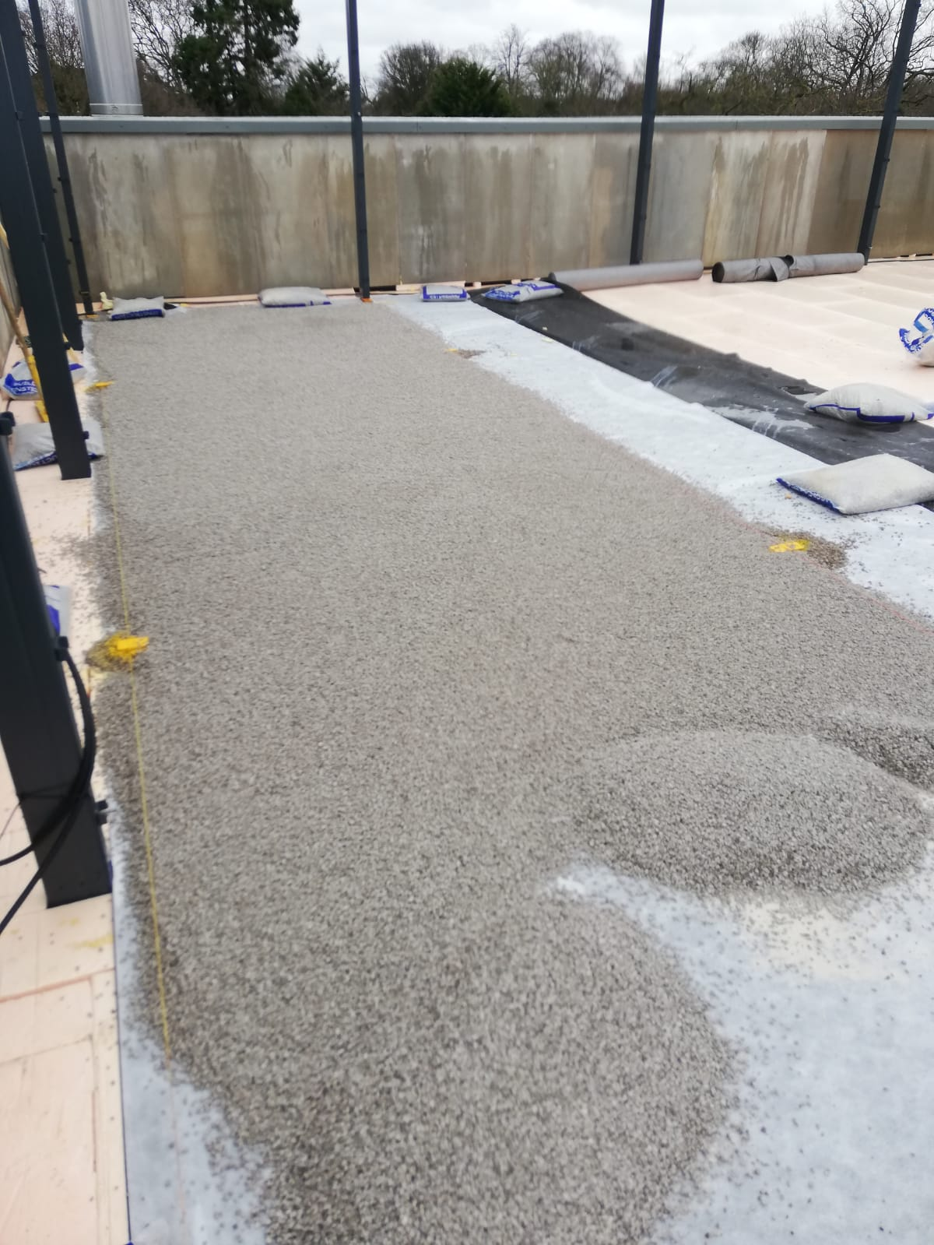
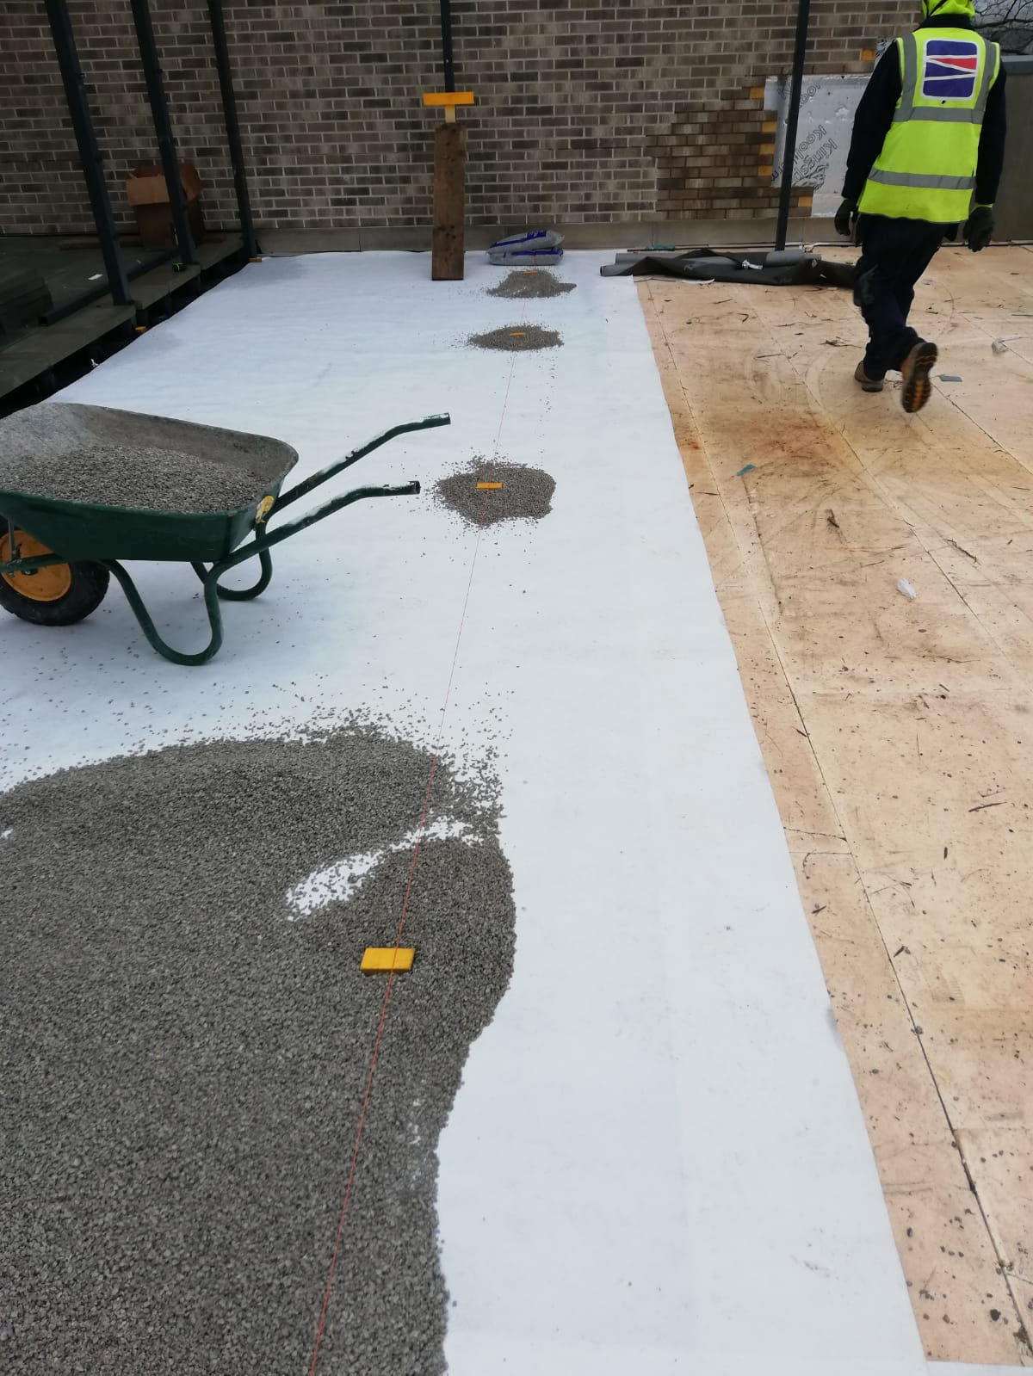
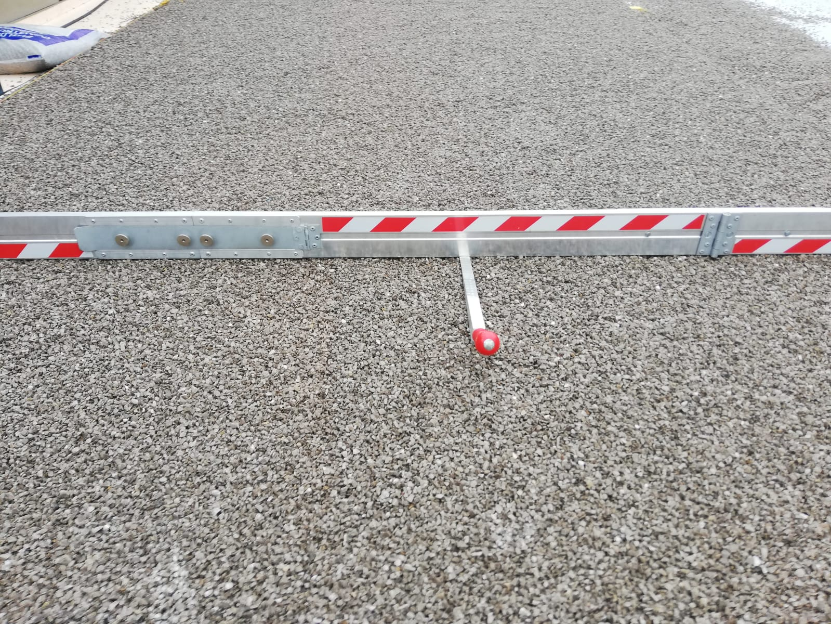
Gravel Regulating Layer
Gravel is deposited in bays and levelled by hand.
The gravel is checked at regular intervals to ensure surface regularity.
(>10mm) Over 3m Edge

Slide 11
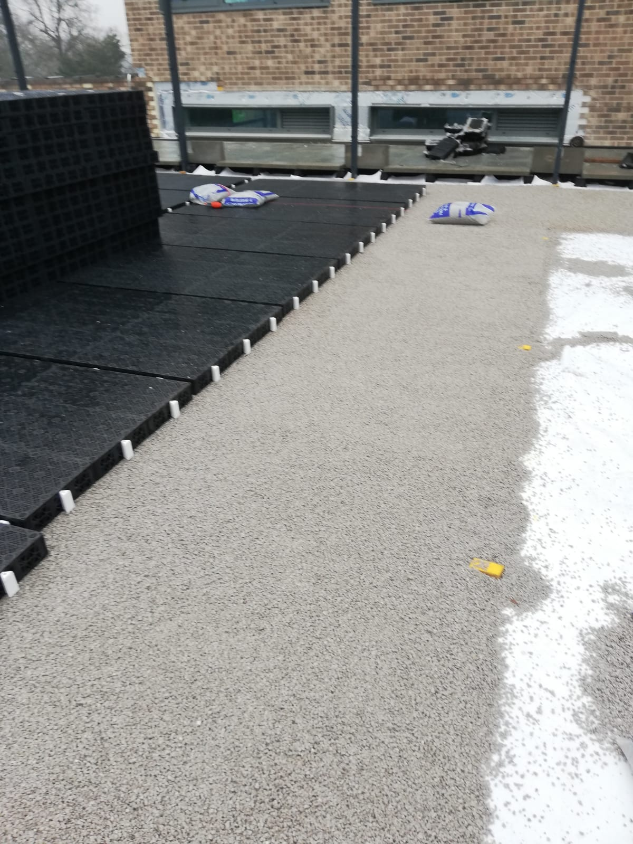
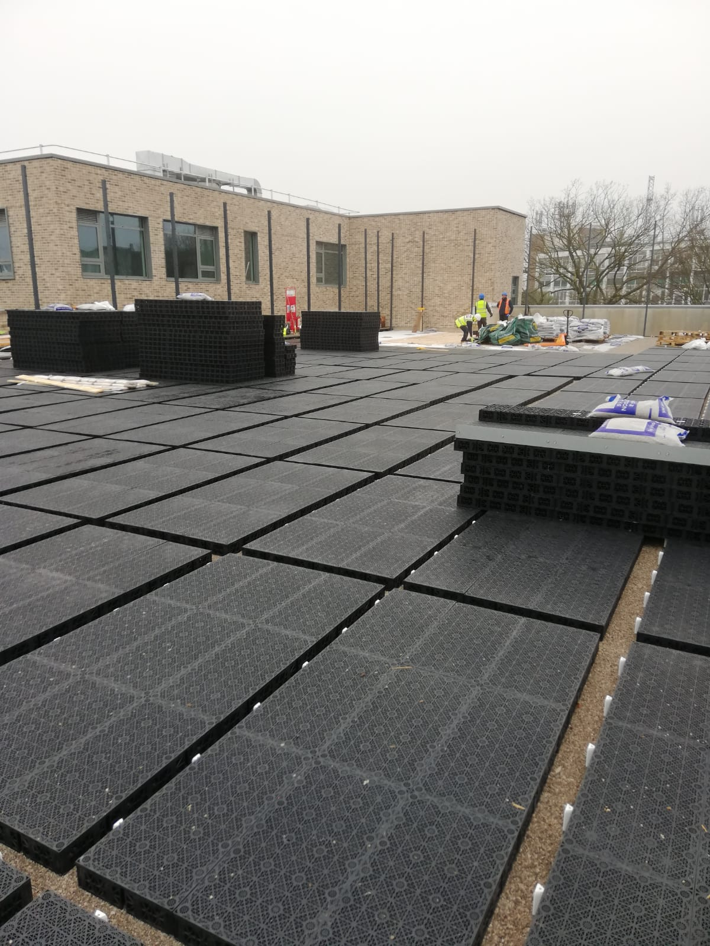
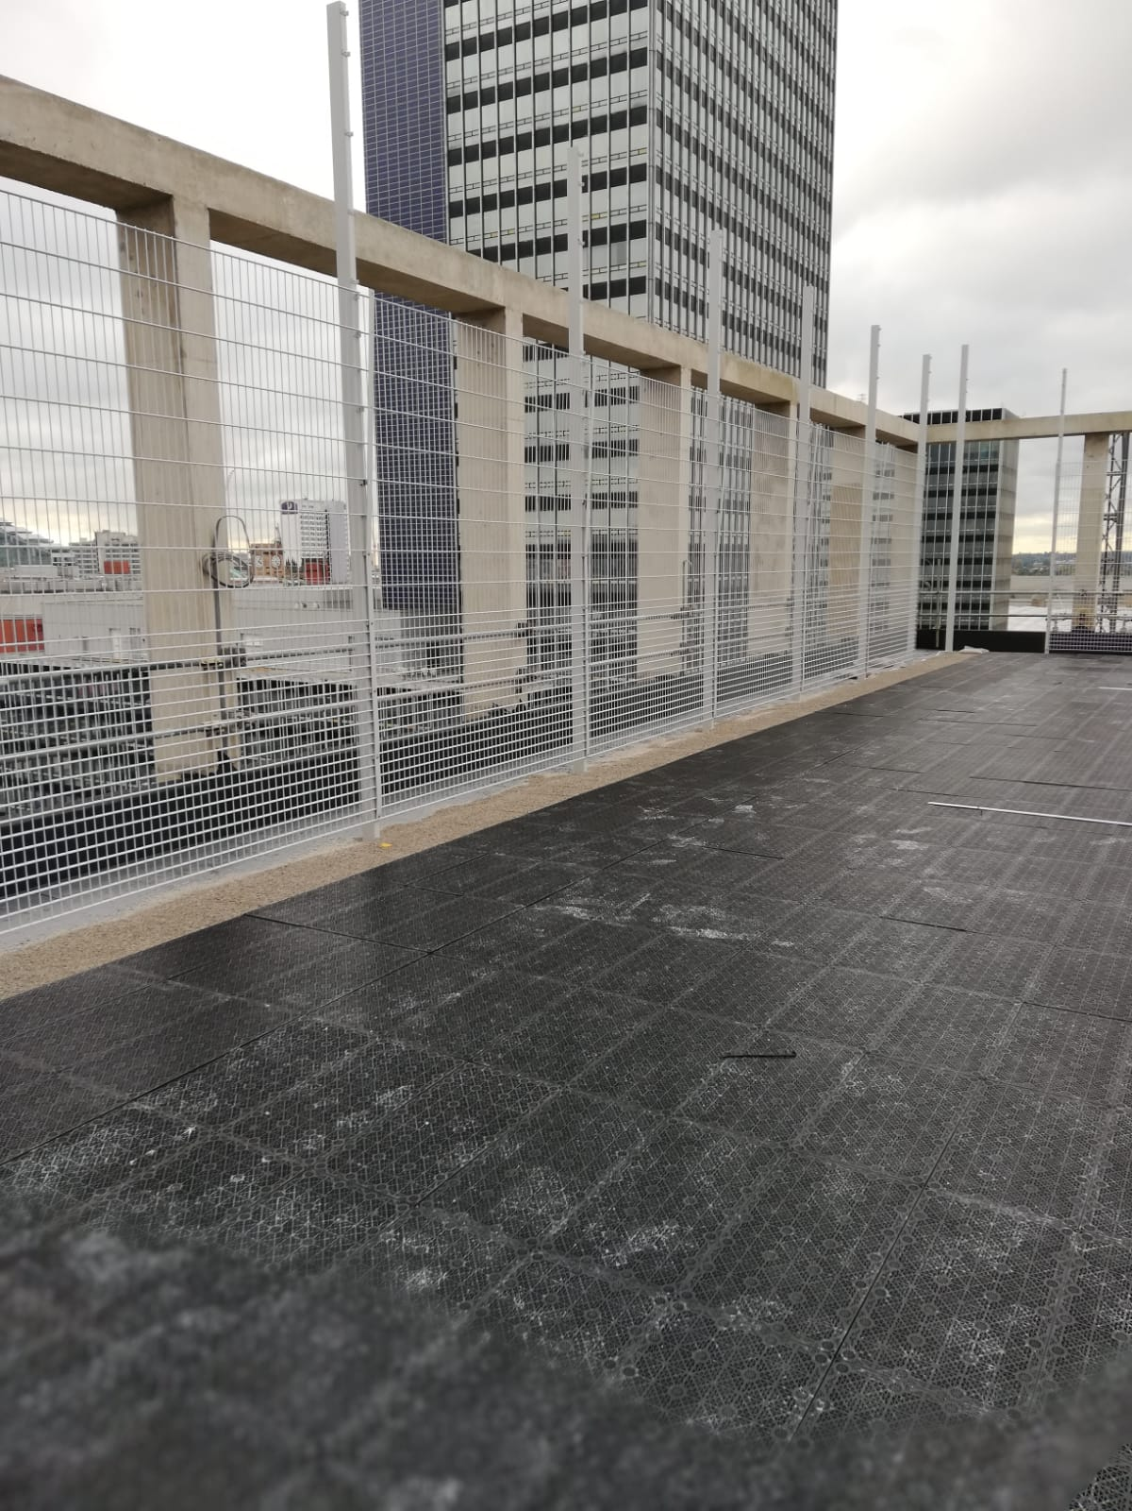
Drainage / Sub-base Replacement Layer
The drainage/sub-base replacement system is then installed by hand.
The units are placed in panels and then secured together using locking pins.

Slide 12
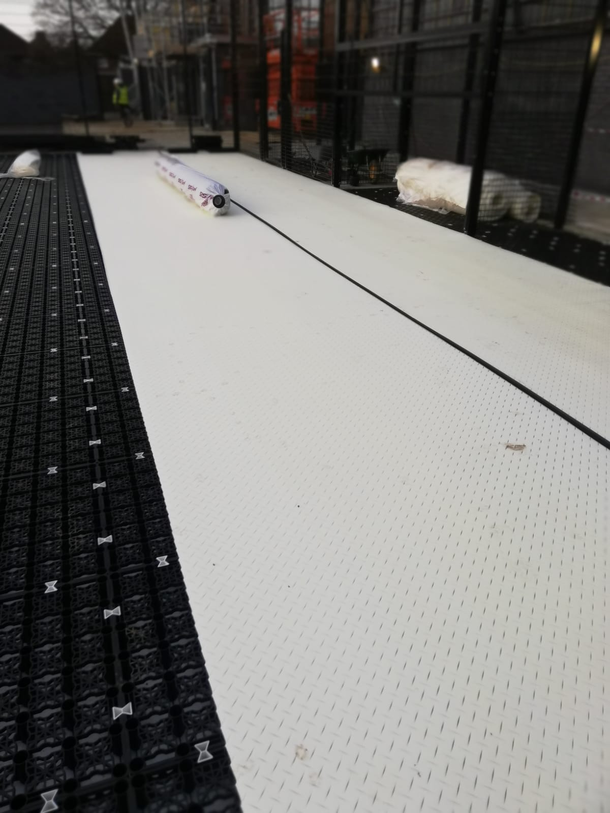
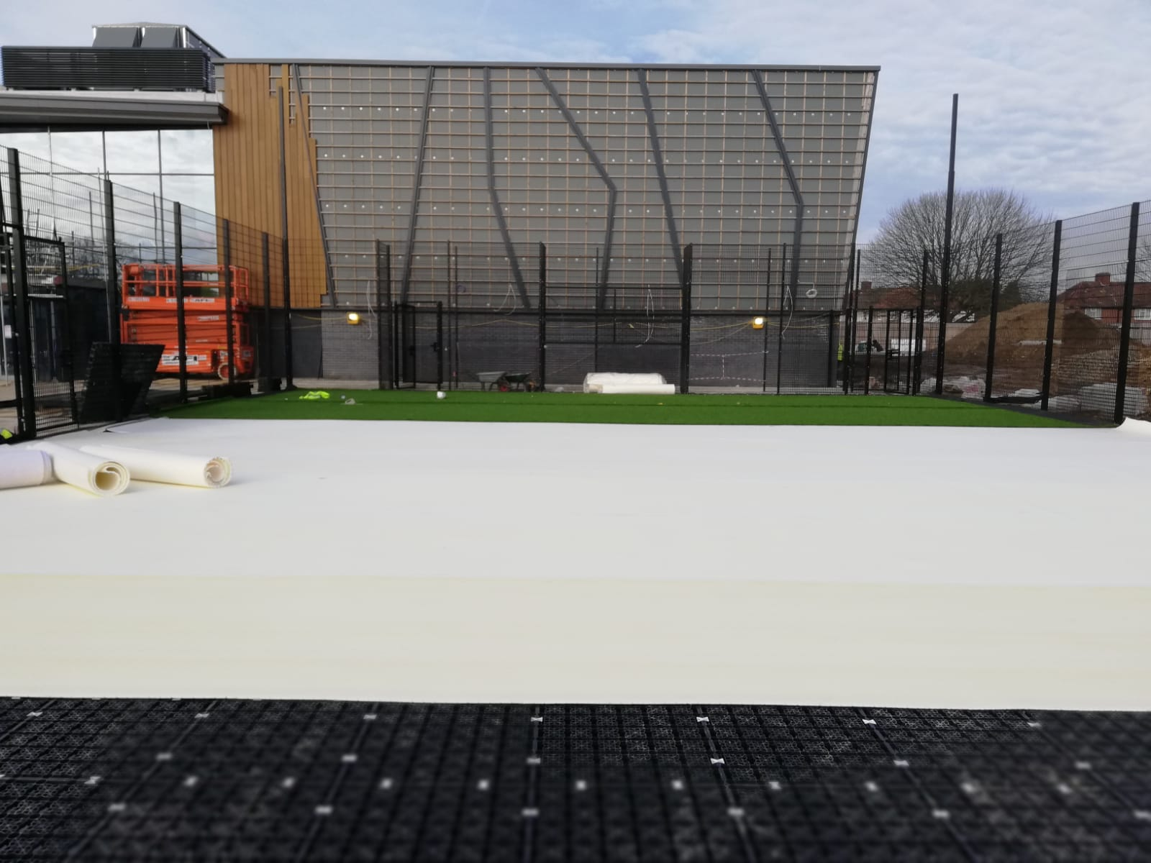
Shockpad
Rolls of pre-fabricated shockpad are rolled out over the area.
All joints are taped.

Slide 13
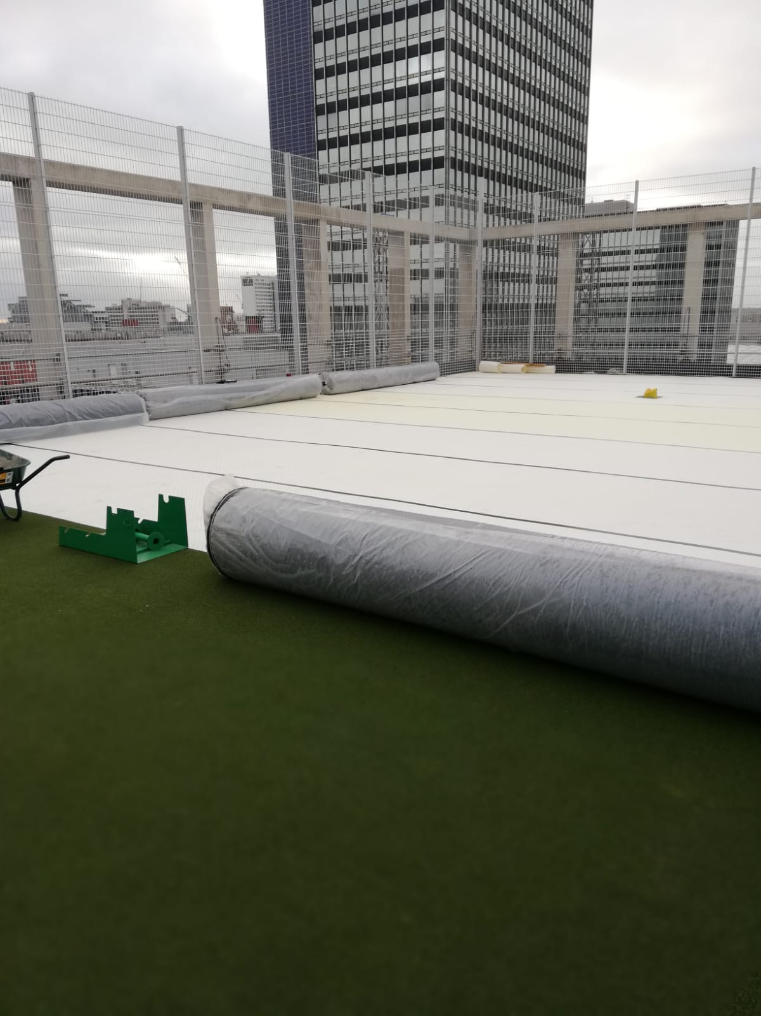
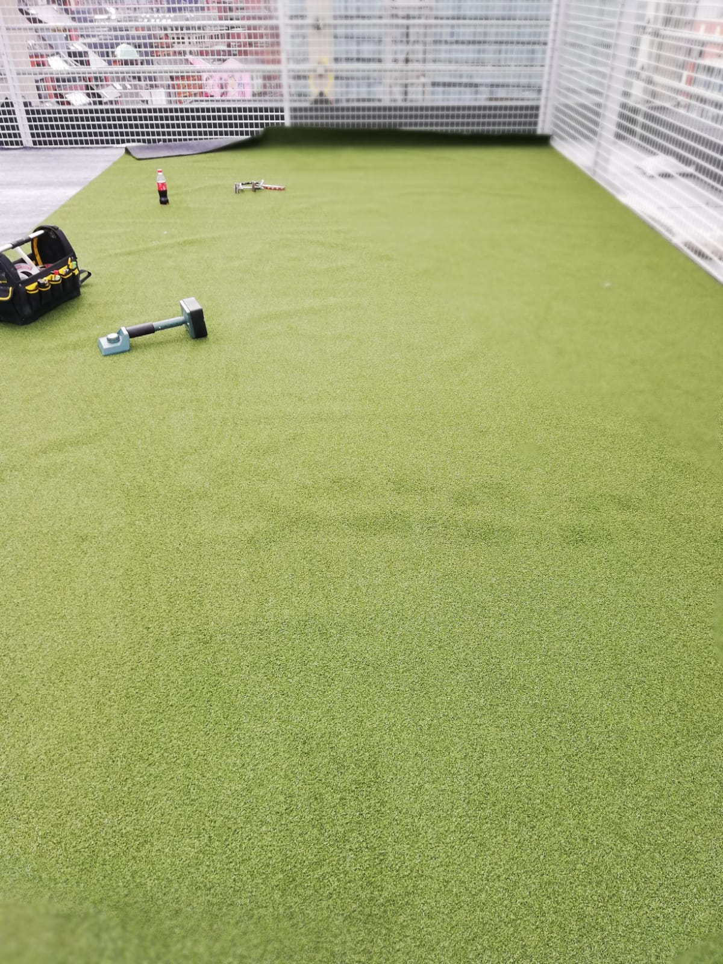
Synthetic Grass
Rolls of synthetic grass are positioned in the correct location in line with the manufacturers roll-plan.
The rolls are then rolled out over the area.
The edges of the rolls are lined up so that they neatly butt up to each other.
Any ripples or creases are removed using a kicker.

Slide 14
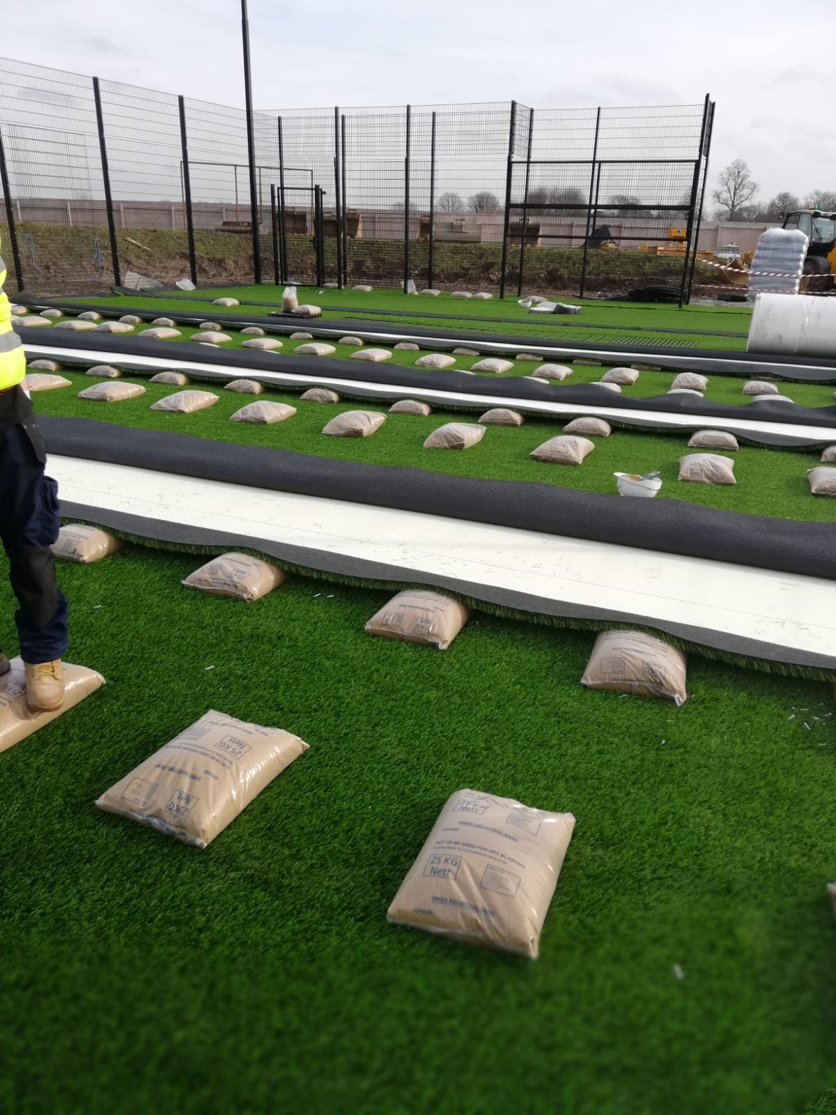
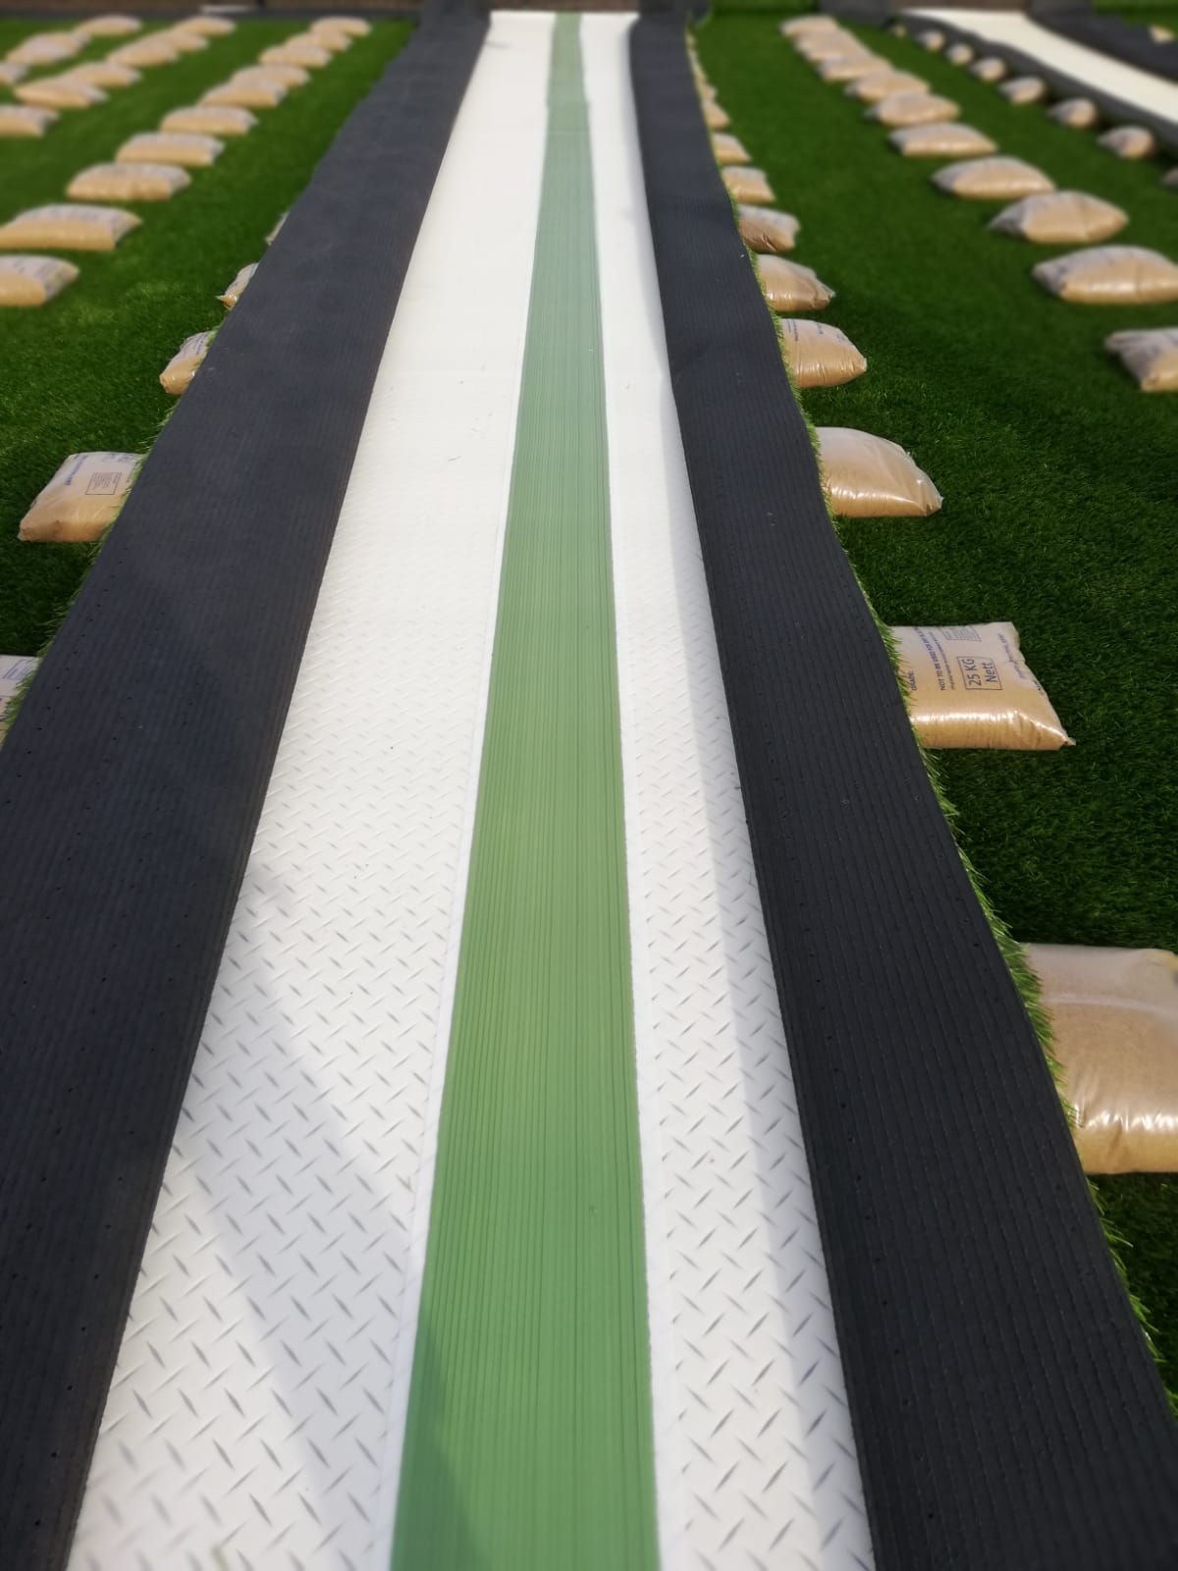
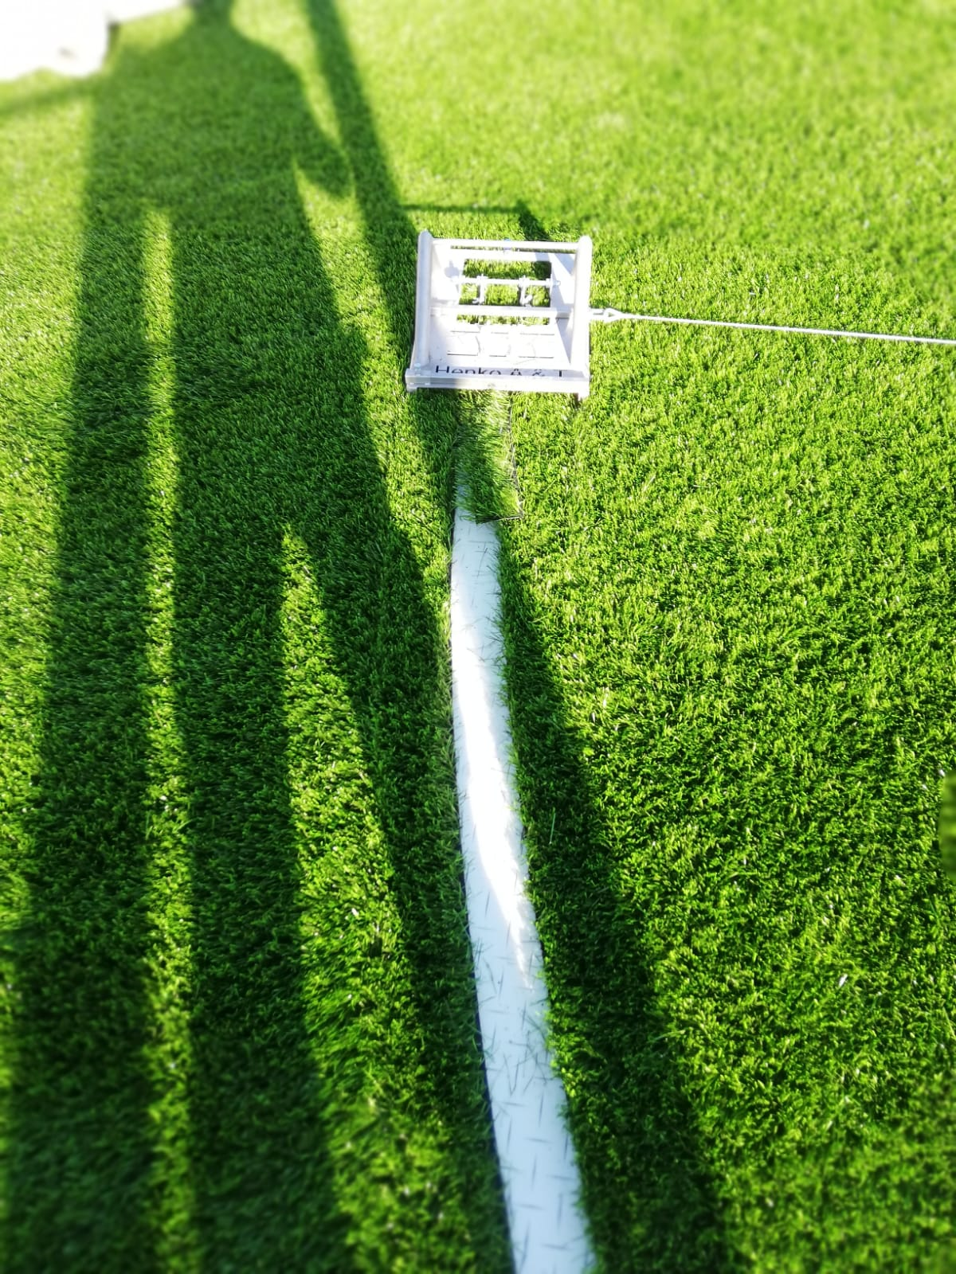
Jointing & Play Lines
The edges of the rolls are then peeled back in preparation for jointing.
A strip of jointing tape is dispensed and covered with adhesive.
The roll edges are then pressed into the adhesive and left until cured.
Play lines are marked and then cut out using specialist cutting tools.
Coloured line marking material is
then inlaid and secured with tape and adhesive.

Slide 15
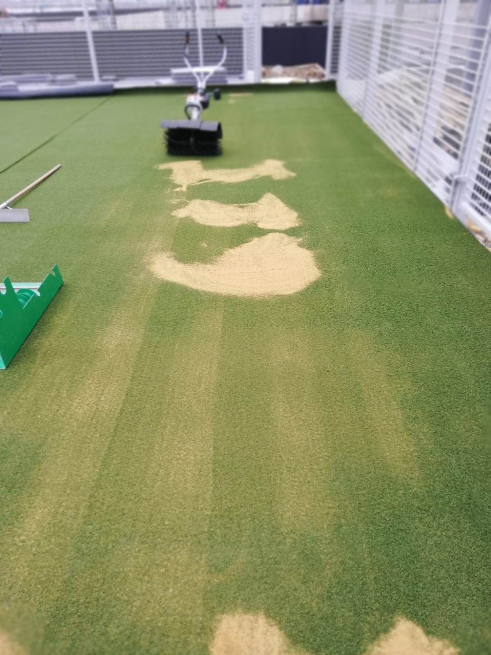
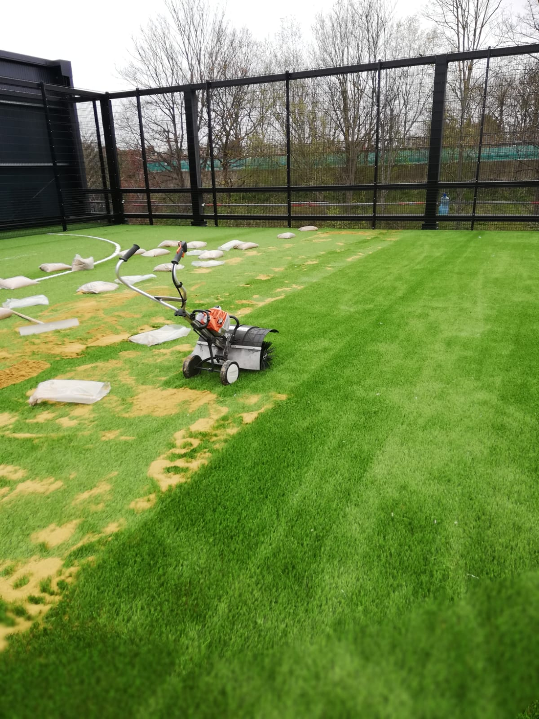
Infill & Brushing
Silica sand infill is distributed over the synthetic grass in accordance with the grass manufacturers recommended spread rate.
The sand is then brushed into the surface using a walk behind power brush.

Slide 16
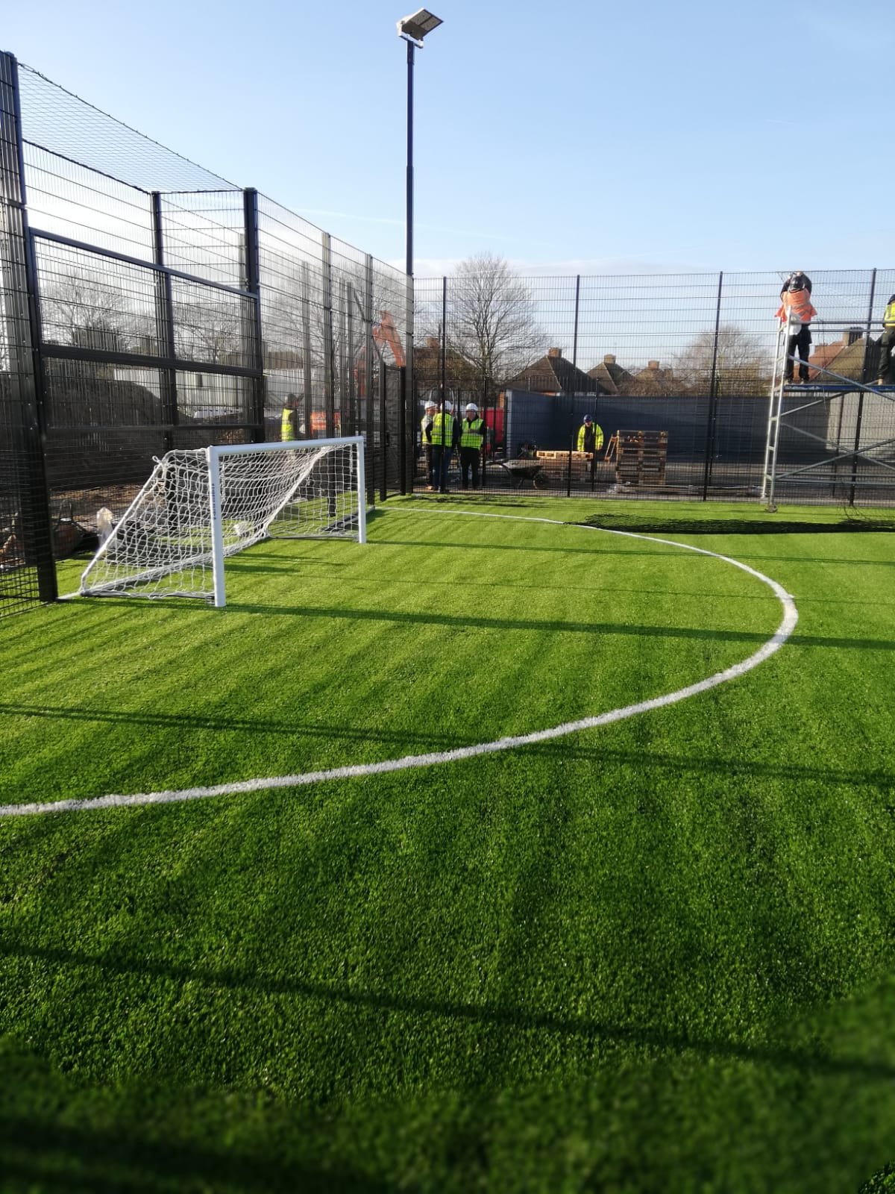
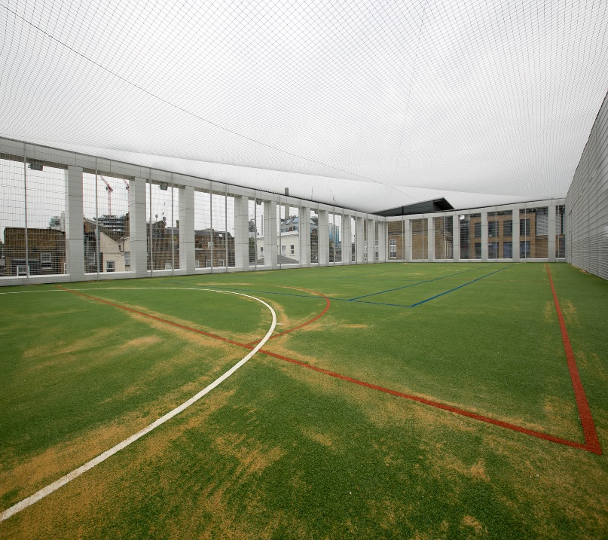
Fence Panels & Roof Net
Fencing panels are then clad onto the fence posts using anti-tamper fixings and clamp bars.
The roof net is then suspended on tensioned steel line wires braced by the fence posts.

Slide 17
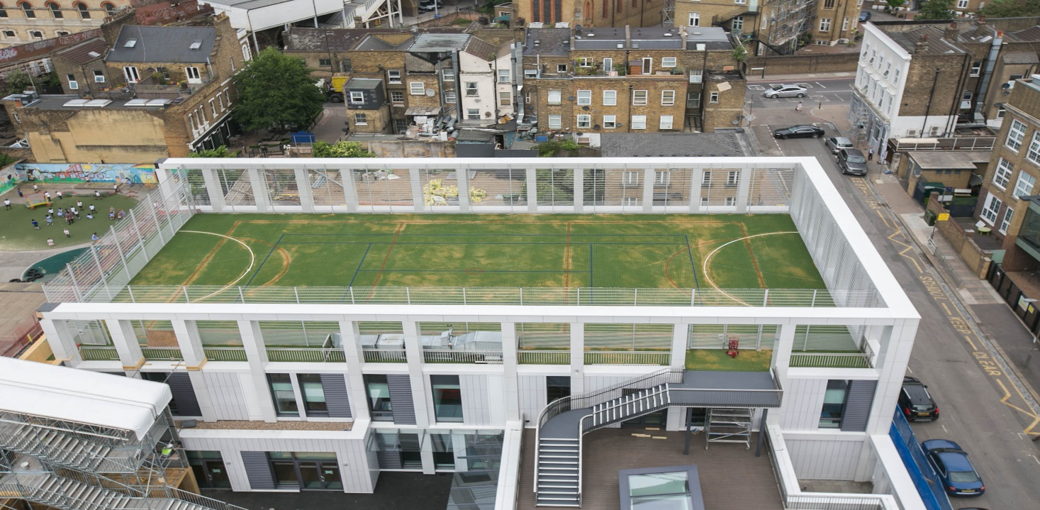
COMPLETION

Slide 18
Thanks for Listening
Any Questions?

