Slide 1
SEL Source PP
Effective use of Permeable Pavements
within a Sustainable Drainage System (SuDS)
Notes:
First Slide and title of todays presentation.
Introduce yourself and welcome all attendees

Slide 2
Agenda
Who are SEL?
Why Permeable Pavements?
Effective Permeable Pavement Design Principles
Example Permeable Pavement Layouts
Key Benefits
Questions
Notes:
Run through bullet points of presentation agenda, with appx. Timings of c.45mins for main presentation followed by 15mins of questions.
Mention there is an opportunity to request further information / discussion on the feedback form, fill in and return to presenter after CPD is finished.

Slide 3
Learning Objectives
How to Treat Run-off (downpipes)
How to Discharge Run-off into / out of Voided Sub-base
How to Maximise Attenuation within a Voided Sub-base
How to Increase the Storage Capacity of a Voided Sub-base
Using Modular Attenuation Units
Using Checkdams
How to Encapsulate a Permeable Pavement
For Infiltration
For Attenuation
For Enhanced Hydrocarbon Treatment
Notes:
Run through bullet points.

Slide 4
Who are SEL?
Achievements Co-Author on the following published technical papers:
The Next Generation of Oil Trapping Porous Pavement Systems
Recent Developments In Oil Degrading pervious Pavement Systems
Improving Sustainability
Flow resistance of panel of geosynthetic materials used for conveyance in stormwater source control
Performance of an oil interceptor incorporated into a pervious pavement
Steering group member of:
CIRIA Project RP637 Source control using constructed pervious surfaces, hydraulic, structural and water quality performance issues
CIRIA Project RP663 SUDS hydraulic, structural and water quality advice
CIRIA Project RP664 Model Agreements for sustainable water management systems
CIRIA Project RP697: SUDS updated guidance on technical design and construction
CIRIA Project RP698: SUDS – promoting good practice
CIRIA Project RP714 Biodiversity and Buildings HR Wallingford Report SR656 The use of SUDS in high density developments
Notes:
SEL have assisted Developers, Architects, Engineers and Contractors in the provision of innovative sustainable drainage solutions across the construction industry throughout the UK for over 20 years. Over this period we have developed an extensive range of solutions, products and services specifically designed and developed to satisfy the growing criteria of local LLFA's.
SEL have been involved in numerous CIRIA projects and the publication of several white papers. SEL have developed a reputation to provide high quality systems and an all round service. SEL excel where the works aren't run of the mill and our engineering ability is put to the test to provide a technical solution.
In addition SEL is a quality assured contractor specialising in membrane works and tank installation for gas protection and surface water applications.
SEL maintain a commitment to continued research and development through the Knowledge Transfer Partnerships (KTP) and collaborate with several Universities (Coventry), leading SuDS designers (Robert Bray, EPG) and manufacturers (Polypipe) to develop new solutions to satisfy the demands of an ever changing construction industry and the demanding criteria of LLFA's as our climate continues to change. We offer a turnkey partnership for the transition from design to installation.

Slide 5
Why Use Permeable Pavements?
Satisfy Planning Conditions
Source Control
Amenity
Treatment
Biodiversity
Cost
Notes:
Government requirements for SuDS on developments in England came into force in April 2015 and are being implemented through the planning system. The new measures must be applied by local planning authorities (LPAs) through local policies and plans, as well as planning application decisions on ‘major developments’ of 10 or more dwellings and equivalent non-residential or mixed developments
SuDS should deliver,
QUANTITY - control water runoff, reducing flood risks, protect the natural water cycle, permeable pavements are ideal for source control.
QUALITY – manage the quality of runoff to prevent pollution. CIRIA*, the leading body in the research for SuDS, states that 60-95% of suspended solids and 70-90% of hydrocarbons can be removed by permeable pavements.
AMENITY – create and sustain better places for people. Permeable pavements are dual function not only providing a method for stormwater management but can enhance surrounding for the end user.
BIODIVERSITY – create and sustain better places for nature. Permeable pavements are shallow which can allow simple incorporation of rain gardens, ponds and tree pits which are all ideal platforms to attract wildlife / insects.
When designed effectively, permeable pavements are a very cost-effective way to provide multiple functions. 1. an all weather usable hard surface 2. runoff collection 3. conveyance 4. infiltration and 5. attenuation.

Slide 6
Effective Permeable Pavement Design Principles
Utilise driveways and shared access roads wherever possible to form micro-catchments of permeable pavement.
Infiltrate surface water run-off whenever possible.
If infiltration is not viable, maximise attenuation volumes within the voided sub-base for each micro-catchment by optimising outflow rates.
Introduce run-off from downpipes into the voided sub-base of each micro-catchment.
Standardise voided sub-base thicknesses for each micro-catchment to simplify construction.
Provide a uniform, flat laying surface to simplify installation of membranes and geotextiles.
Notes:
Run through bullet points on slide, these outline the principles of using permeable pavements more effectively.
The key points are:
Utilise driveways and shared access routes as much as possible.
Infiltrate run-off wherever possible (soakaway tests would be required)
If infiltration is not possible, attenuated within voided sub-base.
Maximise attenuation using flow controls from each micro-catchment area.
Voided sub-base thickness can be standardised across to site simplify construction.

Slide 7
Effective Permeable Pavement Design Principles
Downpipe
Filter
Chamber
Silt
Catchpit
Chamber
Diffuser
Unit
Voided
Sub-base
Diffuser
Unit
Flow
Control
Chamber
Notes:
A visual showing the elements of an effective permeable pavement

Slide 8
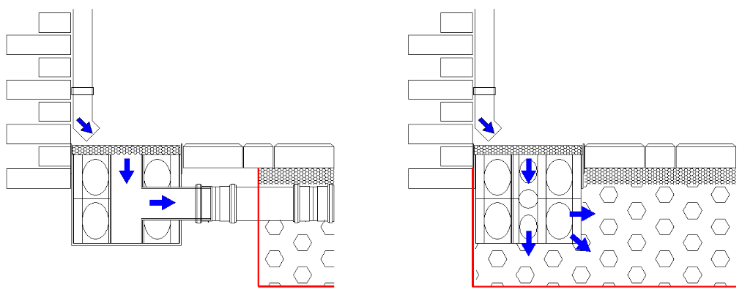
Treating run-off into a Permeable Pavement
(from a downpipe)
Downpipe Filter Chamber
Outside of Permeable Pavement
Downpipe Filter Chamber
Inside of Permeable Pavement
Notes:
Downpipe from rear or outside / away from permeable paving, discharges on to a filter chamber which has a piped connection to the permeable paving.
Downpipe at front or within permeable paving, discharges directly onto an ‘erosion pad’ filter chamber. The downpipe could discharge directly onto the permeable paving but using the filter chamber prevents blockage from siltation and scouring of the blocks/washing away of sand infill.

Slide 9
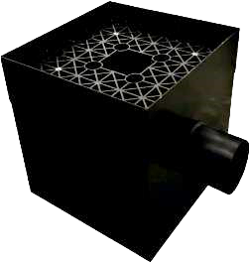
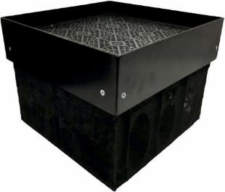
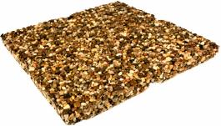
Treating run-off into a Permeable Pavement
(from a downpipe)
Downpipe Filter Chamber
Outside of Permeable Pavement
External Spigot for Pipe Connection
Downpipe Filter Chamber
Inside of Permeable Pavement
Open Mesh Base for Diffusion
Removable Filter / Lid
Resin Bound Gravel
Highly Permeable
Notes:
Using filter chambers can provide the following benefits:
Low maintenance
Self cleansing function
Prevents windfall and debris entering system, can be swept up or blown away by wind
Traps silts within cover
Removable cover for easy maintenance
Visual reminder to maintain

Slide 10
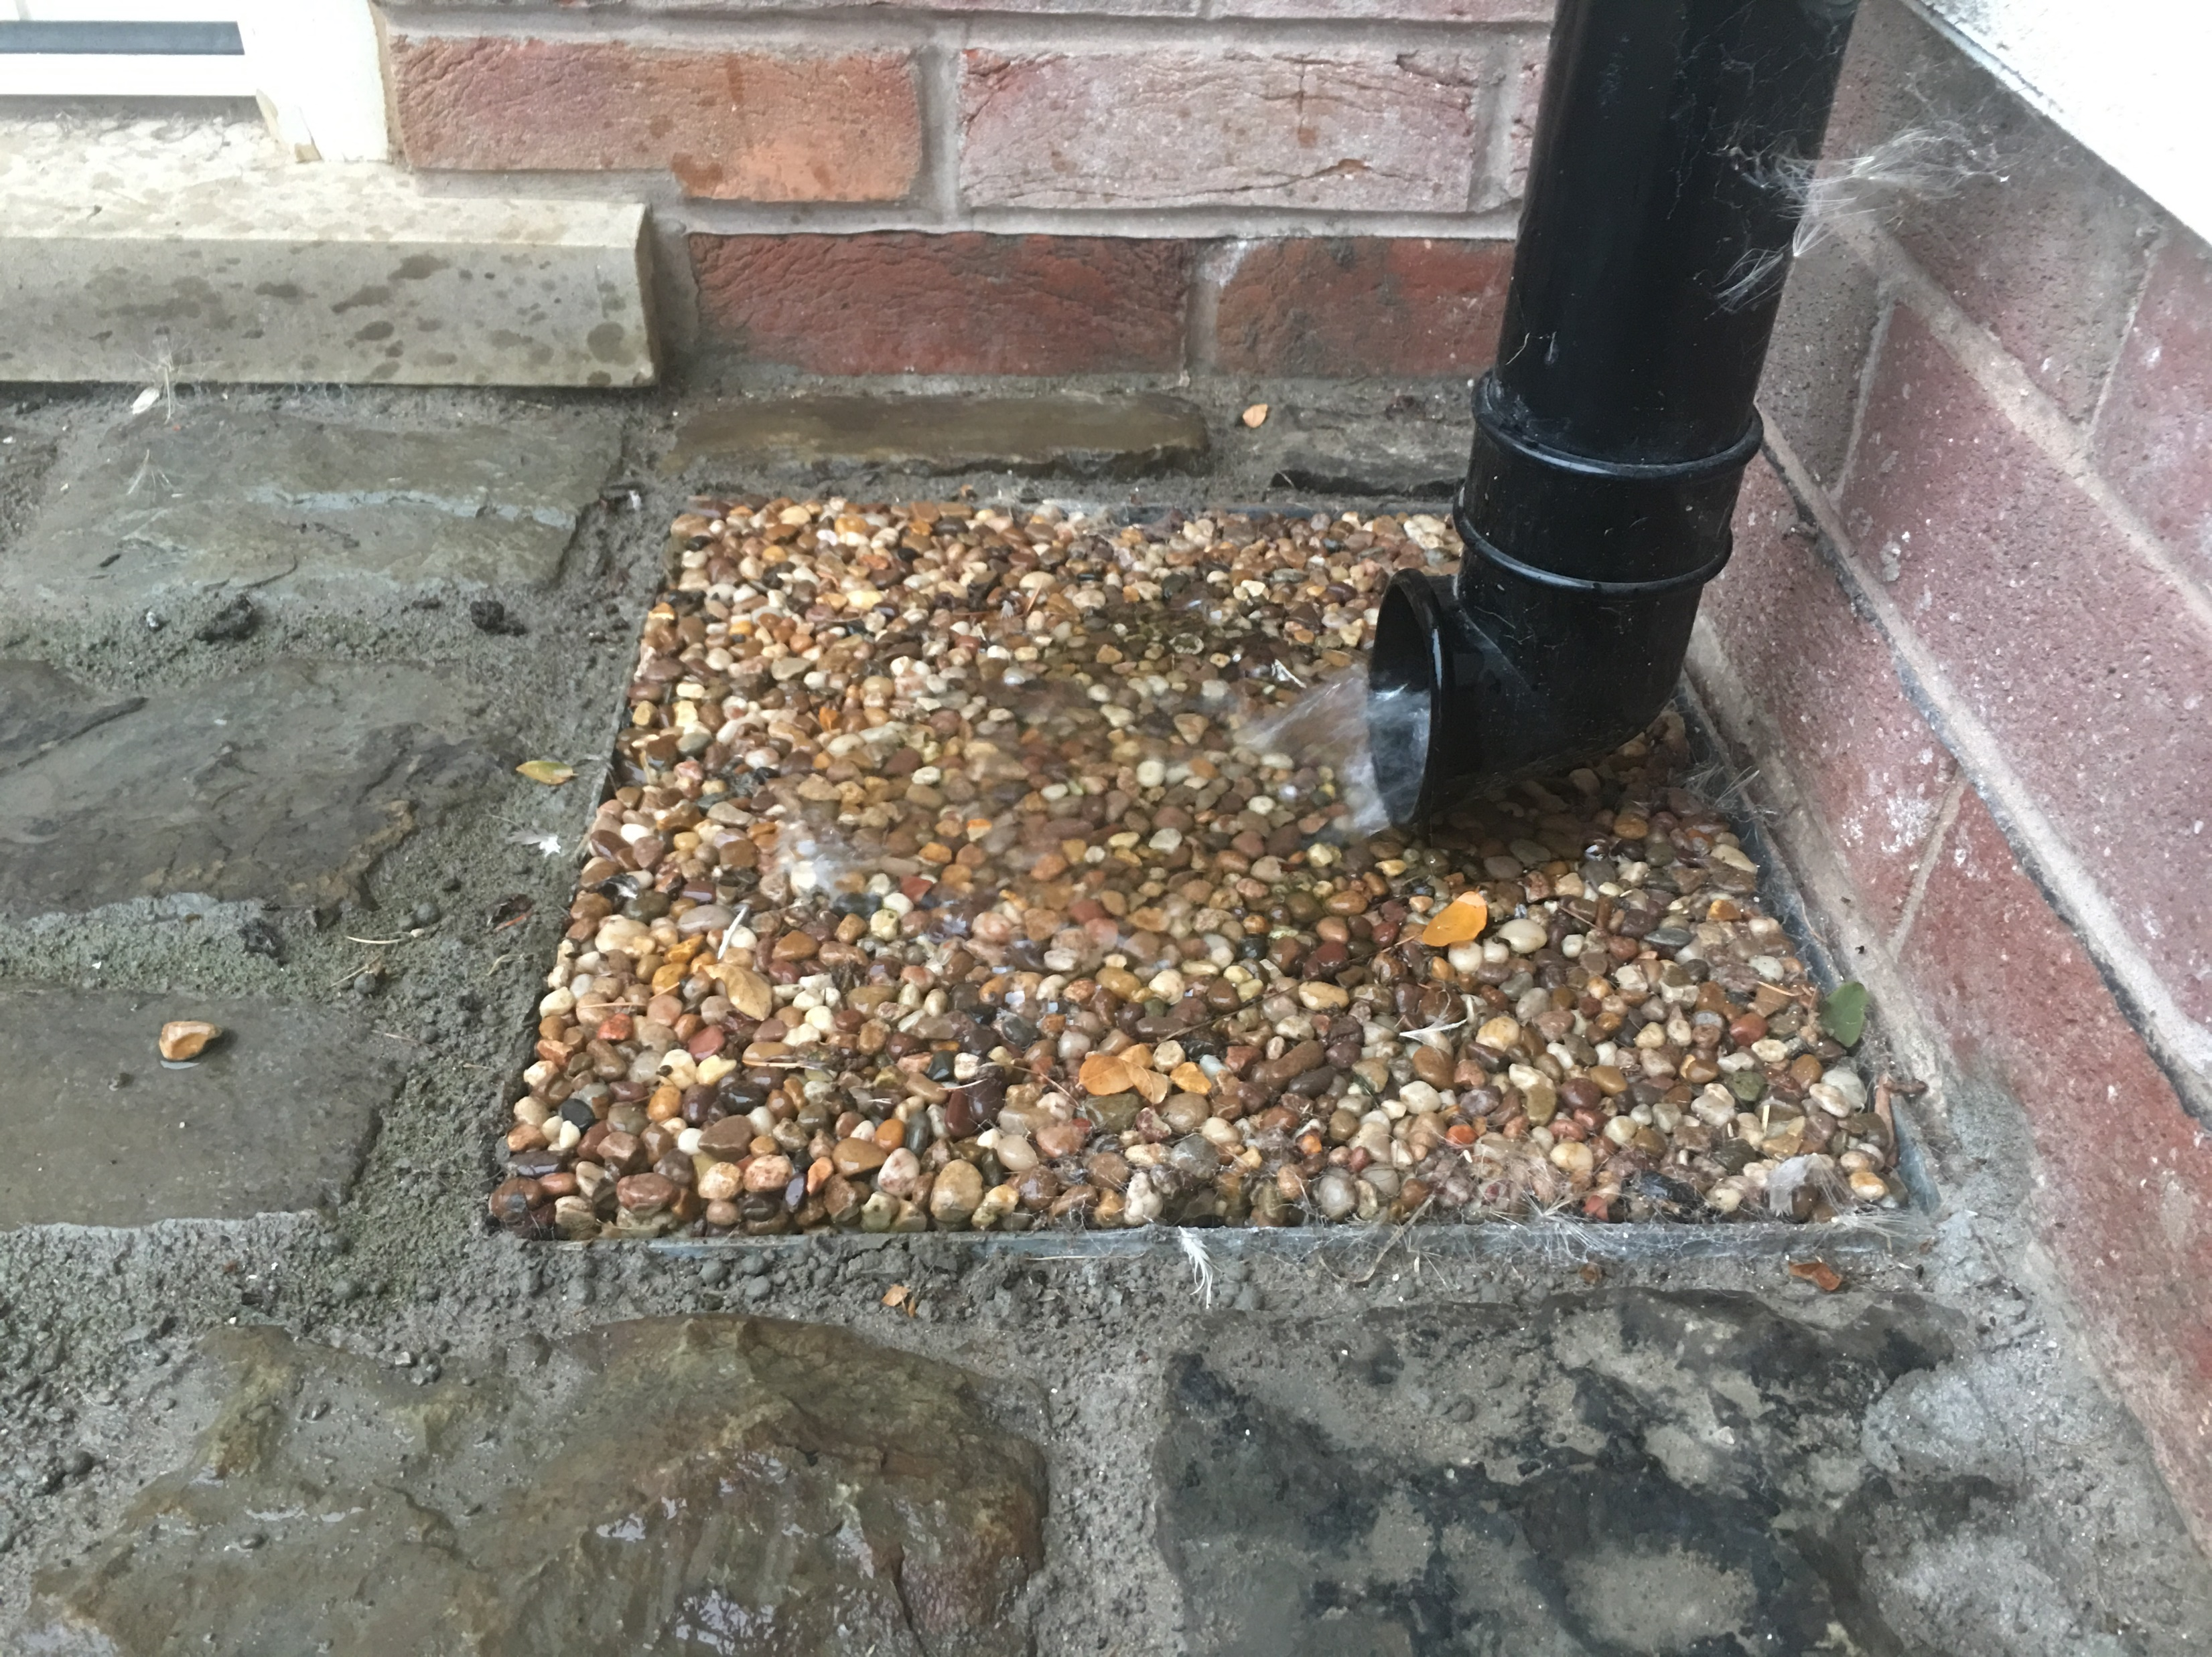
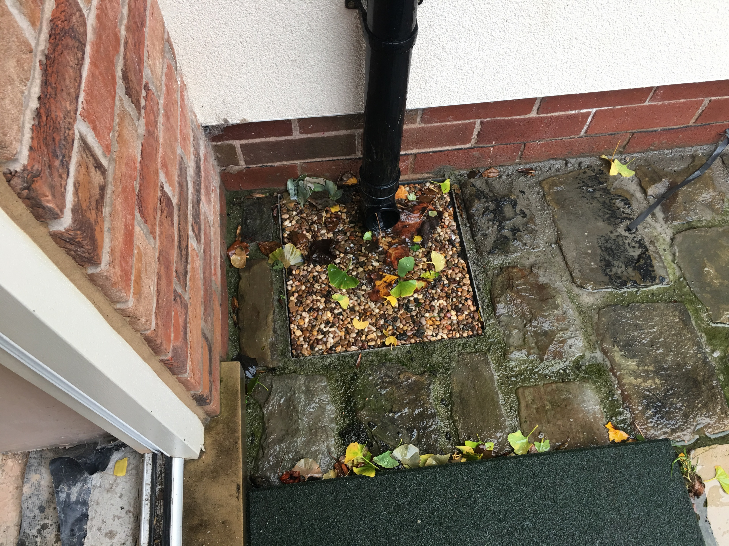
Treating run-off into a Permeable Pavement
(from a downpipe)
Self cleansing function
Prevents windfall and debris entering system
Notes:
Using filter chambers can provide the following benefits:
Low maintenance
Self cleansing function
Prevents windfall and debris entering system, can be swept up or blown away by wind
Traps silts within cover
Removable cover for easy maintenance
Visual reminder to maintain

Slide 11
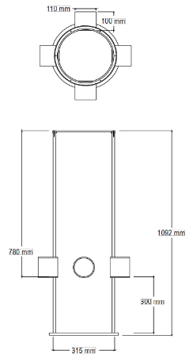
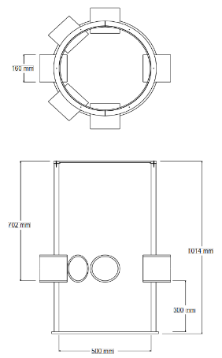
Treating run-off into a Permeable Pavement
(from a downpipe)
Notes:
If your client prefers to use a standard downpipe gully, then it is recommended to place catchpits prior to pipe entries into diffusers / voided sub-base to prevent debris and silts entering into the underground attenuation system and/or pipe network.

Slide 12
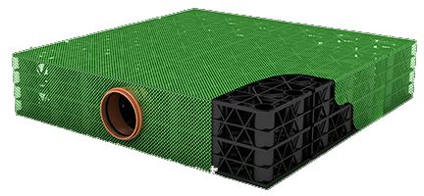
Getting run-off into a Permeable Pavement
Notes:
Diffuser units are made from a plastic modular sub-base replacement system.
The diffuser units are encapsulated in a 2mm mesh fabric which provides a very efficient clog-free surface.
Connections to suit 110mmØ and 160mmØ pipework are available.
A standard 710x710x150mm diffuser will accept runoff from 100m² catchment.
Multiple diffuser units can be combined to satisfy larger catchments.

Slide 13
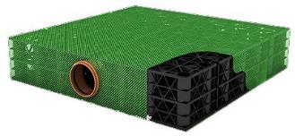
Getting run-off into a Permeable Pavement
Benefits of using a Diffuser
Superior designs
Performance has been determined through a series of rigorous independent tests (CRM Rainwater Drainage Consultancy)
Standard sizes have been modelled
Definitive values for inflow
Definitive values for outflow
Simplify and speedup construction
Notes:
Diffuser units are made from a plastic modular sub-base replacement system.
The diffuser units are encapsulated in a 2mm mesh fabric which provides a very efficient clog-free surface.
Connections to suit 110mmØ and 160mmØ pipework are available.
A standard 710x710x150mm diffuser will accept runoff from 100m² catchment.
Multiple diffuser units can be combined to satisfy larger catchments.

Slide 14
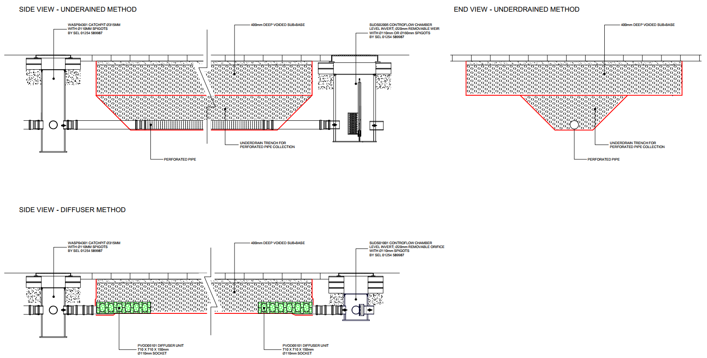
Notes:
UNDERDRAIN METHOD
With the underdrain method you need to allow sufficient cover on the pipework which generally mean it has to be deeper in a trench below the formation of the permeable aggregates.
Its more difficult to construct.
More arisings.
More aggregates.
More cost.
DIFFUSER METHOD
Simplified construction.
Standardised sub-base thickness means level formation.
Less arisings.
Less aggregates.
Less cost.

Slide 15
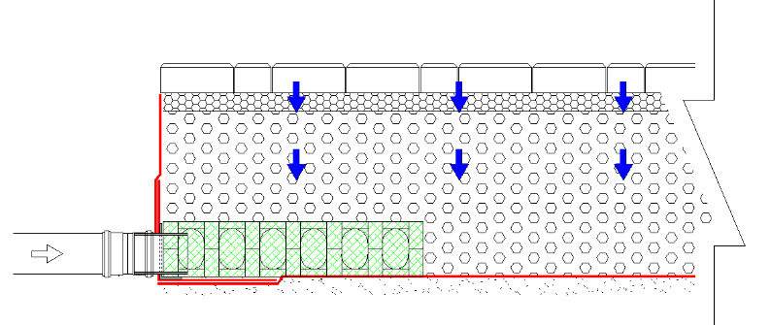
Getting run-off into a Permeable Pavement
Watertight Seal
Inlet
Diffuser
Notes:
Diffuser units can be installed with as little as 130mm of cover in a driveway application, which means that they can always be installed at formation level.
A standard 710x710x150 diffuser will accept runoff from 100m² of catchment.
Multiple diffuser units can be combined to satisfy larger catchments.

Slide 16
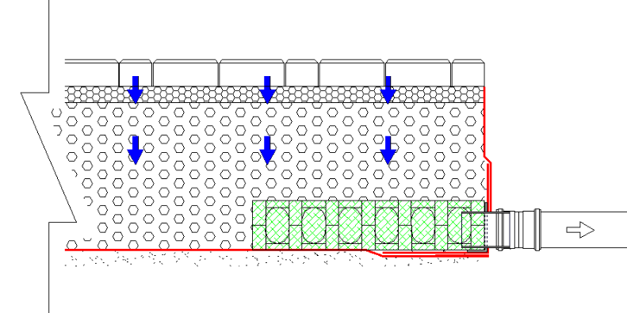
Discharging Water From an Attenuated Permeable Pavement
Watertight Seal
Outlet
Diffuser
Notes:
As well as diffusing runoff into a voided sub-base, diffuser units can also allow water to drain out.
A standard 710x710x150 diffuser can deal with flows up to 3 l/s.
Multiple diffuser units can be combined to satisfy larger outflow requirements.

Slide 17
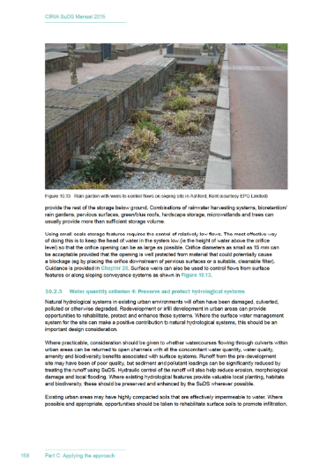
Maximising Attenuation Volume Using Flow Control
(Ciria C753 The Suds Manual, Page 168, Para 2)
Notes:
Maximising attenuation volumes in your voided sub-base can have the effect of reducing the size of the downstream drainage system (pipes, chambers, tanks, detention ponds, etc.).
This can offer a significant financial benefit to the developer and can potentially improve health and safety risk by reducing excavation depths.
To achieve this individual areas of permeable paving will require a flow restriction on their outlet.
Many Water Authorities have historically stated the minimum size opening for an orifice plate is 100mm or the minimum orifice for a vortex flow control is 75mm.
However The SuDS Manual states: “Orifice sizings are allowable down to 15mm diameter” – extract from CIRIA C753 (The SuDS Manual), page 168, paragraph 2. This enables pass forward flows to be better managed.

Slide 18
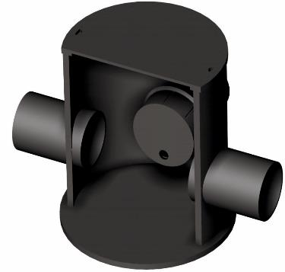
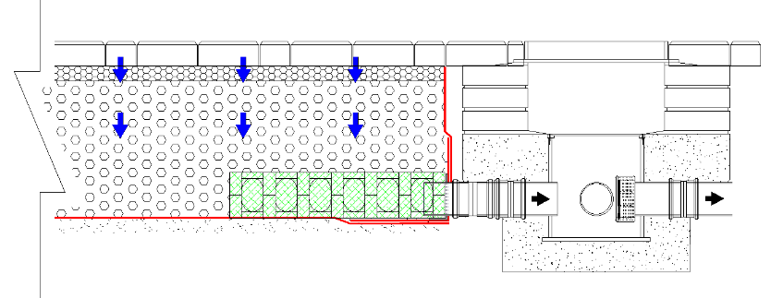
Maximising Attenuation Volume Using Flow Control
Applications: Permeable paving, filter drains and other shallow SuDS elements where water is pre-filtered.
Notes:
SUDS01001
A shallow 300mm dia. flow control chamber with a removable, un-guarded circular orifice (to specified diameter), designed to manage pre-filtered outflows from permeable paving or other open graded sub-base constructions.
Its small size and low cost make it ideal for check dams between permeable paving compartments. The removable cap locks into position with the orifice at invert level.
The chamber is suitable for a maximum depth of 600mm from finished ground level to the orifice plate and is supplied with three 110mm diameter inlet pipe connection stubs to offer flexibility.
Max. installation depth 600mm
Min. installation depth 325mm
Is only suitable for permeable paving applications unless upstream protection is provided.

Slide 19
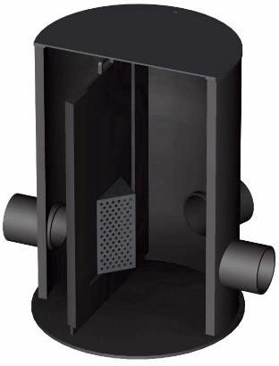
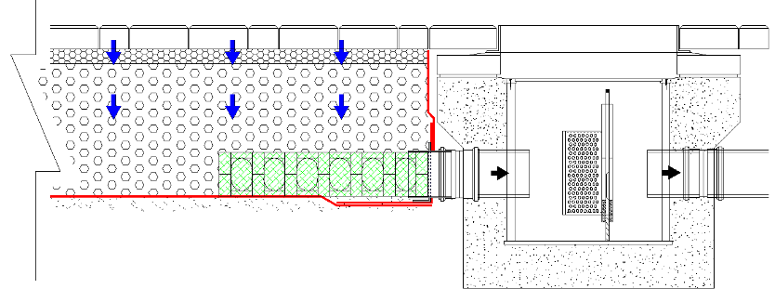
Maximising Attenuation Volume Using Flow Control
Applications: All SuDS elements where water is not pre-filtered and at the end of the management train.
Notes:
SUDS02005
The level invert allows gravity connection to shallow outfalls or permeable construction.
Orifice can be sized to suit individual micro-catchments to maximise attenuation.
Each area can have it’s own bespoke orifice allowing for the drainage area of the micro-catchment.
The orifice is integrated within the weir wall and is protected by a filter screen.
Weir wall is removable to allow cleaning during routine maintenance schedules.
Weir wall height is manufactured to site-specific requirements.
Sump to accommodate the deposition of silt and debris.
Connects to standard underground push-fit PVCu drainage sockets.
Suitable for depths ranging from 537mm to 1.2m (finished cover to base).
An optional foul air trap can be connected when connecting to a combined sewer.

Slide 20
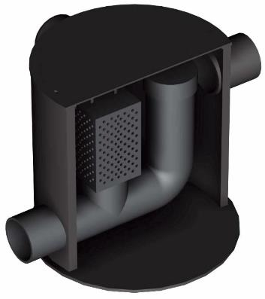
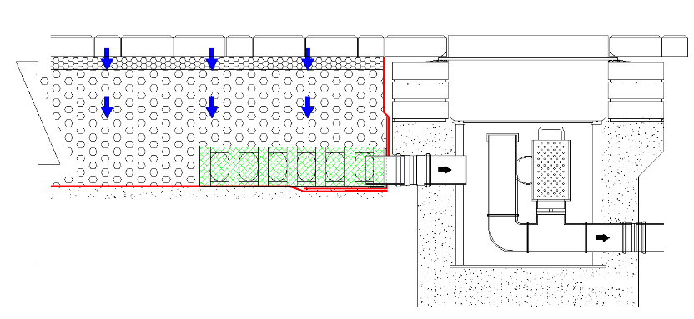
Maximising Attenuation Volume Using Flow Control
Applications: Permeable Paving.
Notes:
SUDS02008
Receives flow from above formation and enables a transition in level with ongoing pipework below formation level.
Orifices sized to suit individual micro-catchments to maximise attenuation.
The orifice is fixed in place to prevent inadvertent removal, but can be removed if necessary using a standard screwdriver.
Removable filter to allow cleaning during routine maintenance schedules.
Integral rodding access point for maintenance.
Sump to accommodate the deposition of silt and debris.
Connects to standard underground push-fit PVCu drainage sockets.
Suitable for pavement depths up to 650mm deep from cover, assuming 4 courses of brickwork.

Slide 21
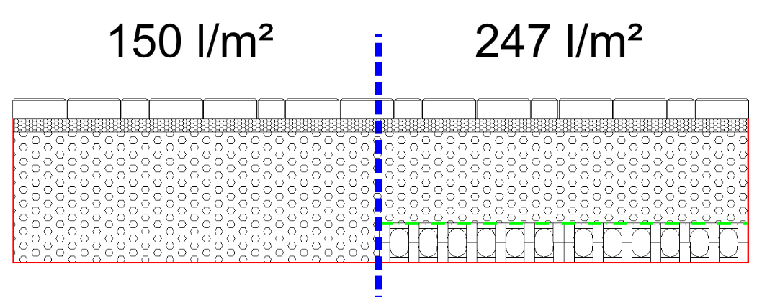
Increasing Storage Capacity of Voided Sub-base
500mm deep
Voided
Sub-base
Normal
Enhanced
Notes:
Standard voided sub-base with a minimum 30% void ratio will store up to 150 l/m2 in a 500mm deep layer of voided sub-base.
The introduction of one layer of plastic modular sub-base replacement units increases storage to 247 l/m2, without increasing the formation depth.
This can be further enhanced by introducing additional layers of plastic modular sub-base replacement units.

Slide 22
Forming Checkdams on Sloping Sites
Unmanaged Slope – 75% capacity
Notes:
Due to gravity, water will flow to its lowest point.
The illustration shows a typical slope where, in this instance, only 75% of the voided sub-base is utilised.
This is further exaggerated over a larger area and will vary for different gradients.

Slide 23
Forming Checkdams on Sloping Sites
Managed Slope – 90% capacity
Checkdam
Diffuser
Notes:
By comparison against the previous example, the introduction of a checkdam arrangement significantly enhances the storage within the voided sub-base.
Pass forward flows are controlled through a flow control chamber.
Water is efficiently collected using upstream and downstream diffuser arrangements.
The example shown does not make any allowance for storage within the plastic modular sub-base replacement units used to form the checkdam itself. Therefore, it is entirely possible that 100% capacity can be achieved in some instances.

Slide 24
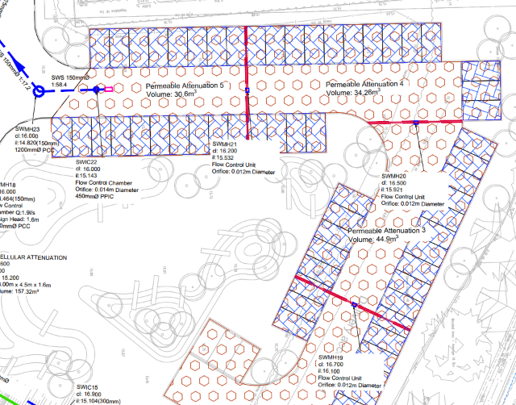
Forming Checkdams on Sloping Sites
Checkdam
Notes:
Example of checkdams from a recently completed project.
Checkdam centres were calculated based on pass forward flows to maximise attenuation with the voided sub-base.

Slide 25
Encapsulating a Permeable Pavement
Geotextile
Treatment Geotextile
Geotextile
Geotextile
Notes:
Normally there are 2 layers of geotextile required.
Between the laying course and the voided sub-base.
Between the voided sub-base and the formation.
The geotextile should function as a ﬁlter.
The tensile properties of the material should be veriﬁed in accordance with EN ISO 10319.

Slide 26
Encapsulating a Permeable Pavement
Geotextile
Treatment Geotextile
Geomembrane
Geomembrane
Geotextile
Geotextile
Notes:
There are three categories of Impermeable Membrane as follows:
IMPERMEABLE MEMBRANE CATEGORY 1
Where the consequences of localised failure of the Impermeable Membrane are minor, 2000 gauge polythene can be used with overlapping joints.
IMPERMEABLE MEMBRANE CATEGORY 2
Where it is important that there is no escape of water (where, for example, contamination would be unacceptable), a more durable material with heat sealed joints should be speciﬁed.
IMPERMEABLE MEMBRANE CATEGORY 3
In the case of Impermeable Membranes installed over occupied buildings (including car parks), the waterproofing will generally form part of the structural construction works.

Slide 27
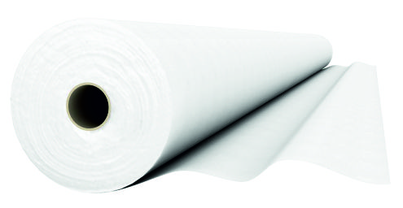
Enhancing Hydrocarbon Treatment
Captures residual hydrocarbons
Removes pollutants by biodegradation
Capable of retaining 6l of oil per 10m²
100% recyclable
Designed to be self-maintaining
Notes:
Where enhanced hydrocarbon protection is required, there are specialised hydrocarbon trapping geotextiles available.
The entrapped hydrocarbons are biodegraded by naturally occurring micro-organisms, providing a self-cleansing mechanism.
These geotextiles are capable of retaining a range of oil contamination types, from daily car drip losses to catastrophic spillages such as car oil-sump failures.
Normally these geotextiles comprises of a proprietary blend of polyester fibres with hydrophilic (water-attracting and oil repellent) and hydrophobic (oil attracting and water repellent) properties to achieve superior oil retention.
A typical enhanced hydrocarbon treatment geotextile is capable of retaining 6 litres of oil per 10m².

Slide 28
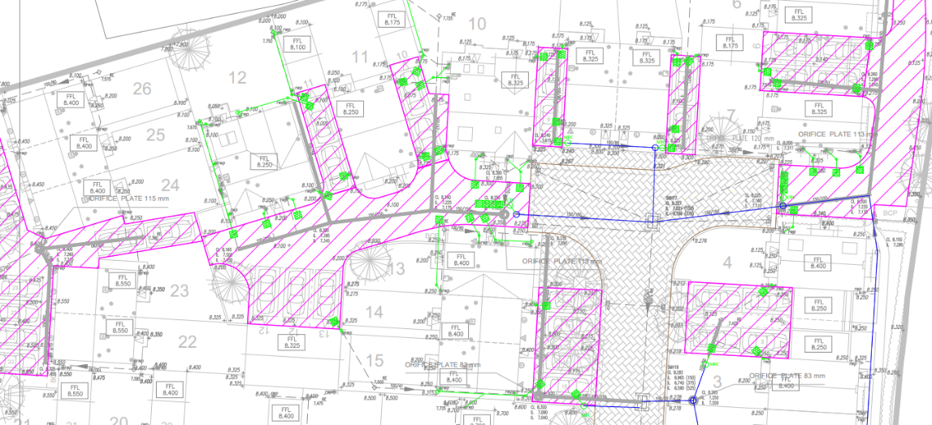
Example Layouts – Using Shared Access Routes
Notes:
Project: Northstowe, Cambridge.
Client: Bloor Homes
Contractor: Durman Stearn
Example shows use of shared access routes to maximise the attenuation potential within voided sub-base.
The pink hatched areas are permeable pavements.
The green squares are diffuser units.

Slide 29
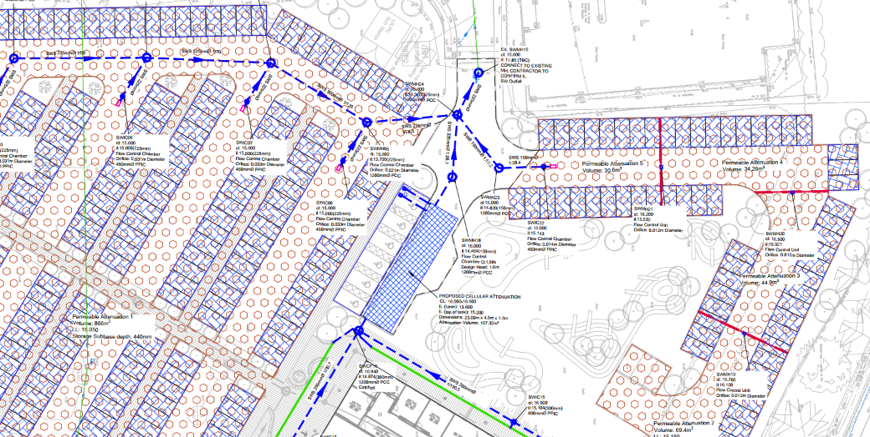
Example Layouts - Checkdams
Notes:
Project: Project Greengrass, Peterborough.
Client: Associated British Foods.
Contractor: Bowmer & Kirkland Ltd.
Example shows the use of checkdams to maximise attenuation by controlling flows through voided sub-base on a slope.
The thick red lines depict checkdams with integral flow control chambers.
Outlet is through a diffuser unit (shown by the pink rectangle)
You will note there is an attenuation tank for roof run-off, effective use of the permeable pavements has kept this to a minimum size.
The original design for this project was only utilising voided aggregates below the permeable parking bays, which necessitated an additional attenuation tank and vortex flow control chamber to provide the full storage requirement for this area. The design also utilised several hundred metres of perforated ‘underdrain’ pipework. The interface between the permeable and impermeable areas would have been very difficult and expensive to construct. The introduction of voided aggregate across the whole car park area meant that all of these issues were avoided and major cost savings were made.

Slide 30
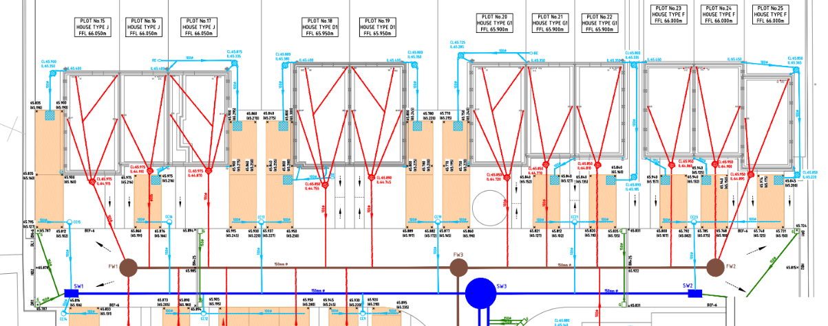
Example Layouts – Voided Sub-base
Notes:
Project: Hanbury Avenue, Grantham.
Client: Lindum Homes Ltd.
Contractor: O’Boyle Bros.
Example shows individual flow-controlled drives with attenuation provided solely within voided aggregate sub-base.
The beige rectangles are permeable drives with voided sub-base.
The cyan squares are diffuser units used to inlet roof run-off.
You’ll note that each area of permeable paving has its own individual flow control chamber.

Slide 31
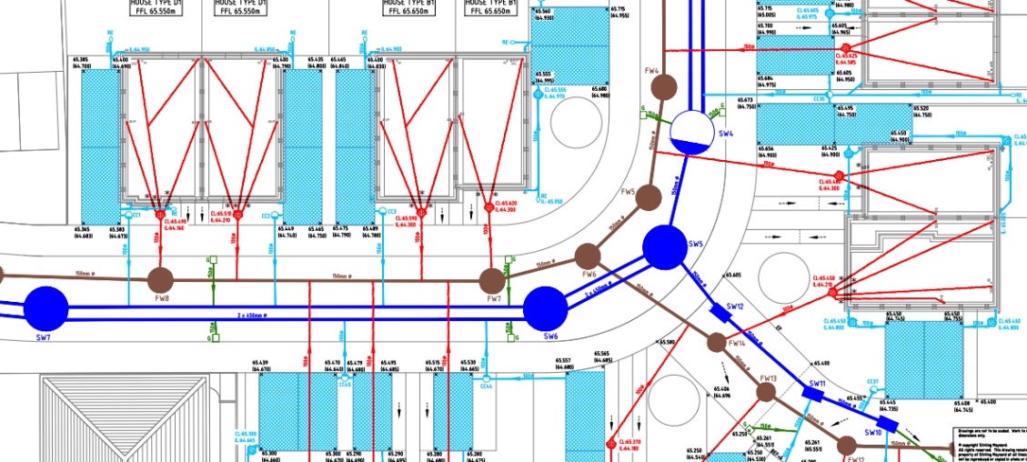
Example Layouts – Enhanced Attenuation
Notes:
Project: Hanbury Avenue, Grantham.
Client: Lindum Homes Ltd.
Contractor: O’Boyle Bros.
Example shows individual flow-controlled drives with attenuation provided with voided sub-base incorporating a single layer of plastic modular sub-base replacement units.
RWP pass through filter chambers and connect to the plastic modular units.
Voided sub-base is installed over the geocellular modular units.

Slide 32
Benefits of Effective Permeable Pavements
Satisfies planning requirements for SuDS, source control & treatment.
Optimises storage within voided sub-base.
Enables permeable pavements on brownfield sites or sites that are unsuitable for infiltration.
Allows connection from roofs.
Allows the use of permeable pavements on sloping sites.
Provides a uniform flat laying surface by eliminating ‘underdrain’ pipework, which simplifies and speeds up construction.
Can be installed towards the end of construction, potentially avoiding contamination of sub-base during building works and eliminating ‘sacrificial’ asphalt layers.
Can reduce imported stone volumes.
Can reduce volume of excavation and ‘muck away’.
Can reduce pipe/manhole diameters and depths throughout the site and can also reduce the volume required in end-of-line ponds.
Includes prefabricated, cost-effective, low-flow flow controls.
Often eliminates the requirement for pumping off-site by reducing excavation depths for the entire site drainage system.
Can be utilised with both permeable and impermeable surfacings.
It’s simple!
Notes:
Summary of the benefits when applying the techniques discussed to make better use of a permeable pavement.

Slide 33
SEL Source PP System
Thank you for attending
Any Questions?
Notes:
Open questions section.
If unsure about any point raised, take contact details and offer email reply

