Slide 1
SEL Membrane Systems
By Lee Warwick
Contracts Manager

Slide 2
Contents
Who are SEL?
Types of Membrane
Methods of Jointing
Drainage Pipe Connections
Membrane Protection
Quality Assurance

Slide 3
Who are SEL?
SEL provide high quality, value-engineered solutions for SuDS and contaminated land remediation throughout the UK
Adopt an open-minded approach to developing site specific solutions
In-house stage 1 design capabilities (catchment analysis, sketch layouts, CAD)
Forge and maintain close relationships with leading academic institutions, key research bodies, specialist Consultants and manufacturers
Develop and manufacture a comprehensive range of unique products and bespoke components (flow controls, diffusers, prefab membranes)
Maintain a highly skilled and specialised workforce together with bespoke plant and equipment

Slide 4
Types of Membrane
LLDPE
PE
PP
HDPE
Reinforced membranes

Slide 5
Types of Membrane
HDPE
High density polyethylene.
High density polyethylene (HDPE) geomembrane liners are used in a wide range of containment applications. This material provides excellent durability and chemical resistance properties and is reliable in exposed applications, has ultraviolet protection and ageing resistance from the intense stresses of weather. This is a very stiff membrane.
Various thicknesses and large roll sizes available.
Usually has welded joints.

Slide 6
Types of Membrane
LLDPE
Linear low density polyethylene
Provides much of the same durability and resistance properties found in high density polyethylene (HDPE) geomembranes, but with the added benefit of increased material flexibility because it is a lower-density polymer.
Various thicknesses and large roll sizes available.
Usually has welded joints.

Slide 7
Types of Membrane
PE
Polythene
Polythene sheet is more commonly used as a damp-proof membrane.
Normally 1200 gauge thick (0.25mm) and supplied in rolls 4 m wide by 25 m long.
Usually has taped joints

Slide 8
Types of Membrane
PP
Polypropylene
Outstanding flexibility, elongation (up to 700% before rupture), cold temperature resistance, long term UV stability, and advanced chemical resistance. Polypropylene is one of the most flexible membranes available for use as a fabricated geomembrane, making detail work such as creating corners an easy task.
Various thicknesses and large roll sizes available.
Usually has welded joints.

Slide 9
Types of Membrane
Reinforced membranes
Usually laminated carrier and scrim (grid)
All the benefits of the membrane but with added strength and puncture resistance of the scrim (grid). Very low elongation.
Various thicknesses and large roll sizes available.
Usually has welded joints.

Slide 10
Methods of Jointing
Hot air gun
Extrusion
Tape
Twin wedge welder
Lap

Slide 11
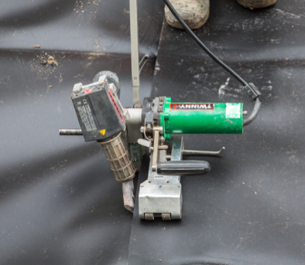
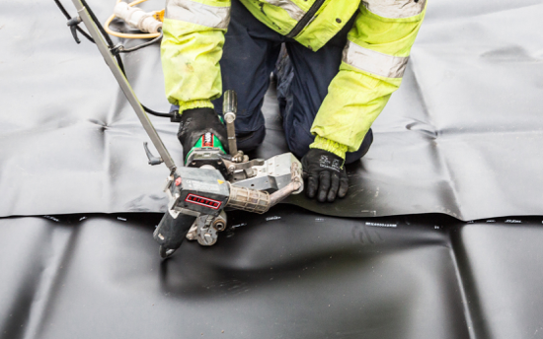
Methods of Jointing
Twin wedge welder

Slide 12
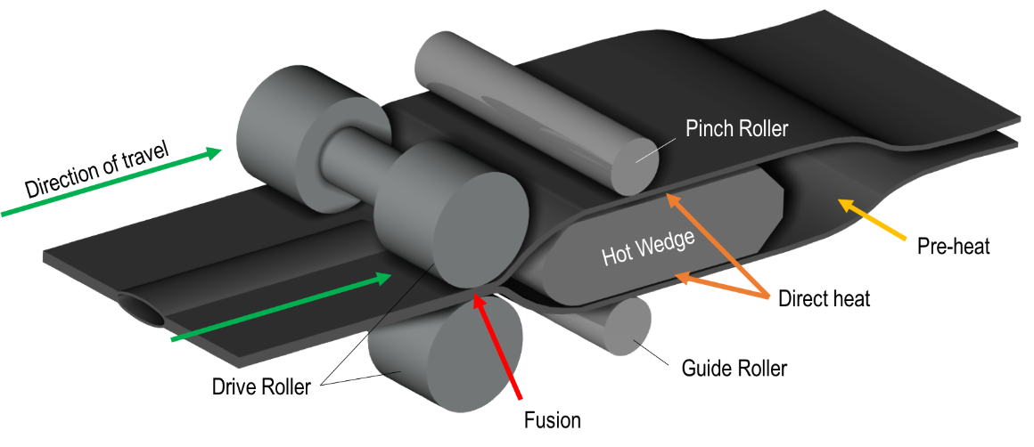
Methods of Jointing
Twin wedge welder

Slide 13
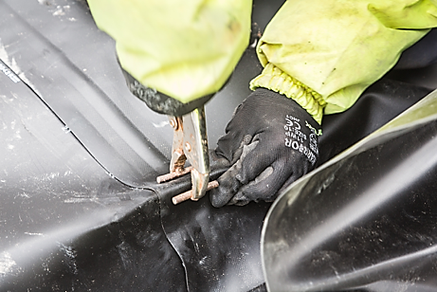
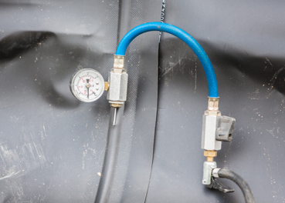
Methods of Jointing
Twin wedge welder – Testing, 1 bar/mm thickness for 5 minutes

Slide 14
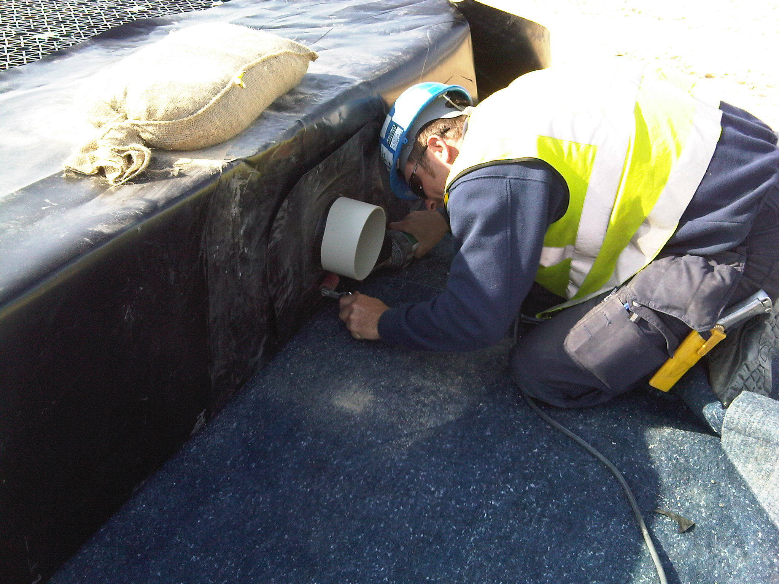
Methods of Jointing
Hot air gun

Slide 15
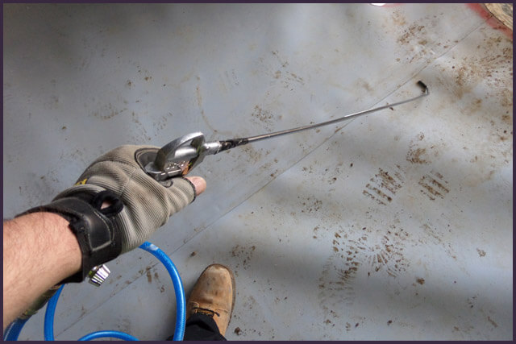
Methods of Jointing
Hot air gun – Testing
55 PSI minimum
5mm nozzle.
<100mm from seam
Traversed at c.12m/min

Slide 16
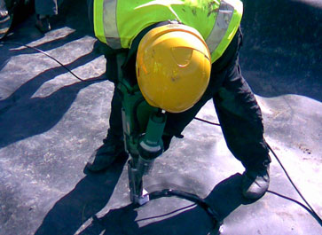
Methods of Jointing
Extrusion welding
Extruding molten plastic
Suitable for PE membranes where hot air welding is not suitable
Relatively slow and therefore expensive compared to other jointing methods

Slide 17
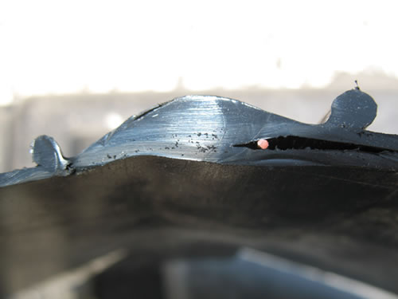
Methods of Jointing
Extrusion welding
Spark test

Slide 18
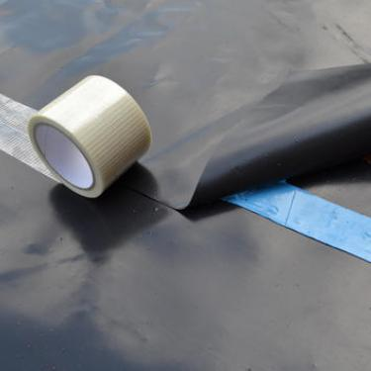
Methods of Jointing
Tape
Needs dry and clean surface
Cannot test joint
Limitations under hydrostatic pressure

Slide 19
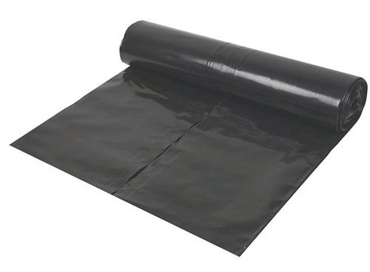
Methods of Jointing
Lap
Usually minimum 300mm
Only suitable where watertightness is not an issue i.e. leaky tank
Fast and cost effective where appropriate
“Token gesture”

Slide 20
Drainage Pipe Connections
Robust
Fit Standard Drainage
Watertight

Slide 21
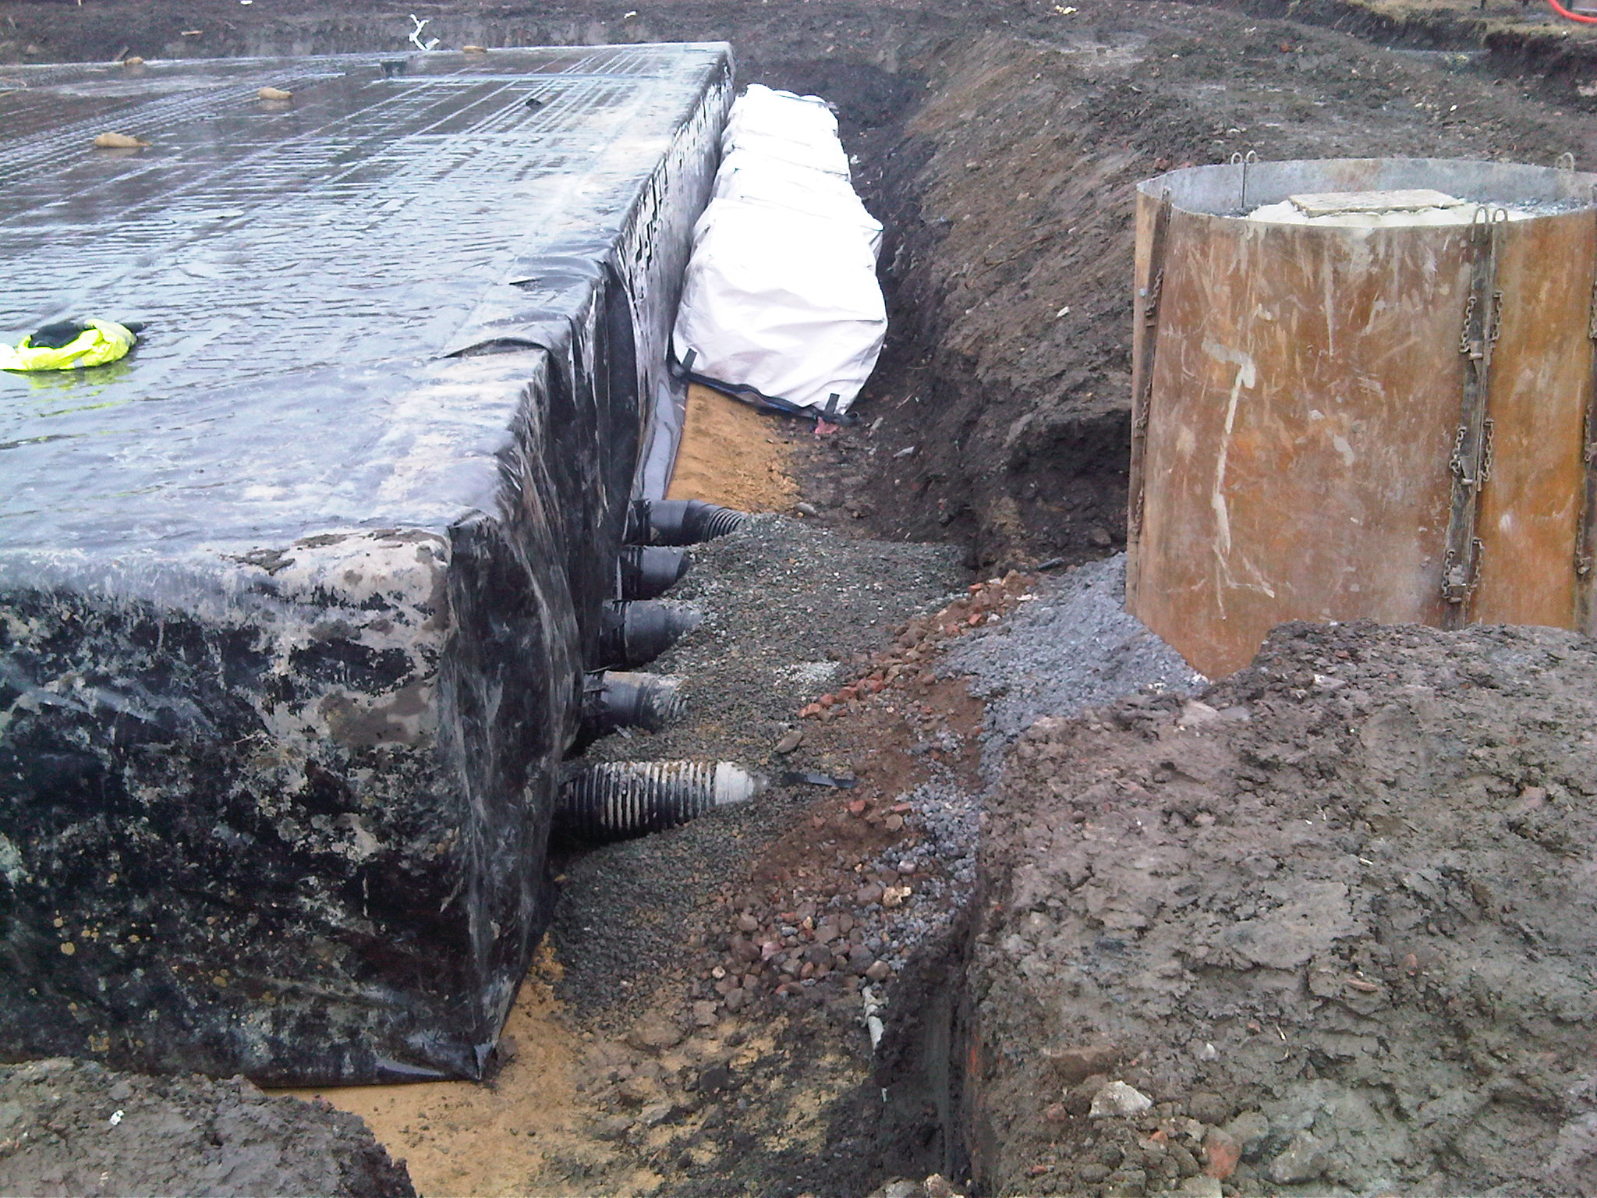
Drainage Pipe Connections
Example of bad workmanship

Slide 22
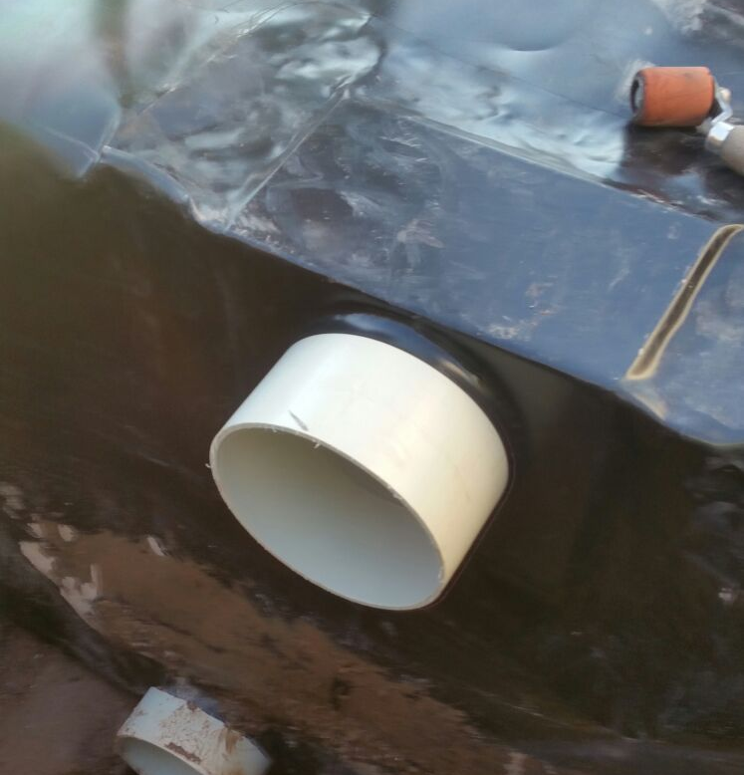
Drainage Pipe Connections
Example of good workmanship

Slide 23
Drainage Pipe Connections
PVOD Components

Slide 24
Drainage Pipe Connections
PVOD Components

Slide 25
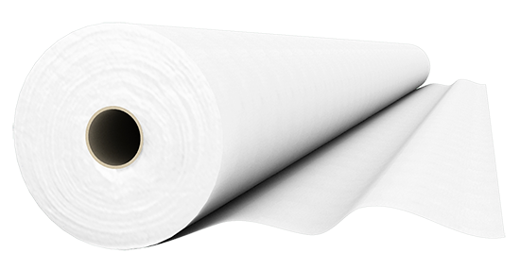
Membrane Protection
Outer layer around membrane
Occasionally on inside of membrane
Prevent puncture during installation and backfilling
Non-woven, needle punched
Minimum 300g/m²

Slide 26
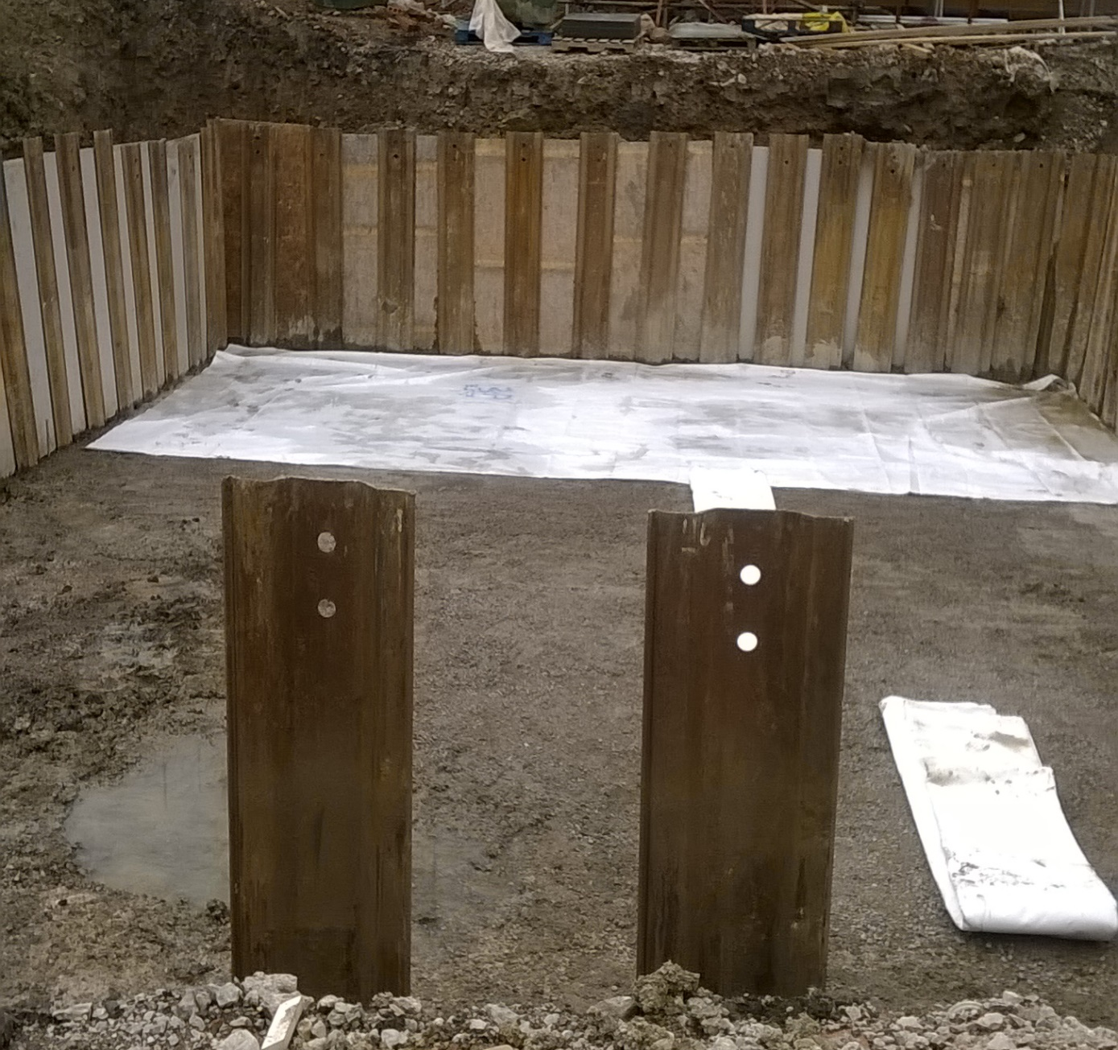
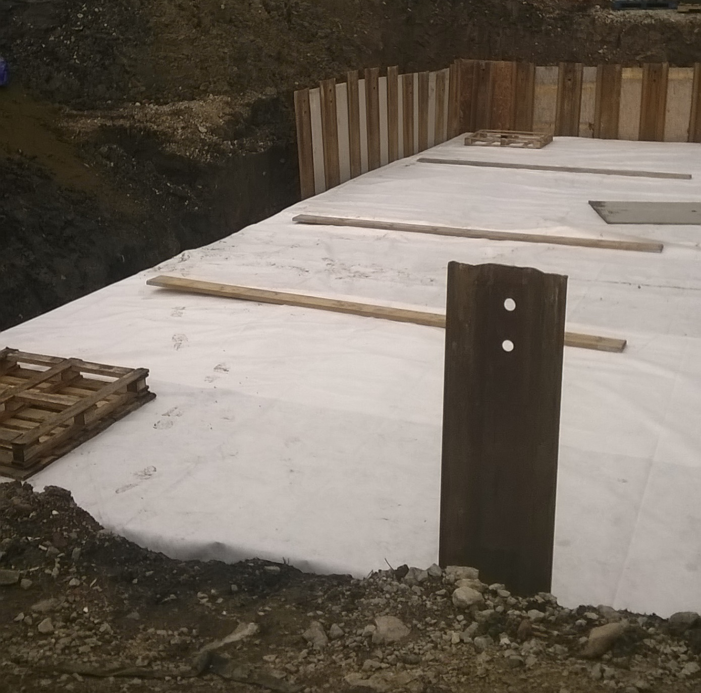
Membrane Protection

Slide 27
Quality Assurance
ISO9001
Quality Plan
On site CQA

Slide 28
Quality Assurance
Quality Plan

Slide 29
Quality Assurance
On site CQA

Slide 30
Any Questions?...
SEL Environmental Ltd
Lee Warwick 07711 377602
l.warwick@selenvironmental.com
www.selel.co.uk

